Slide 1
Fund 2 Performance Review | Q2 2025
July 2025

Slide 2
Executive Summary
Asset Management Operational Review
Financial Overview
Valuations
Fund Forecast

Slide 3
Pending Changes Tracker | Q2 2025 FPR
Topic | Changes | Status
Same Store NOI | Add Same Store Base Rent per Occupied sqf | Completed
Capex | Add reference To Budget/BP | Completed
Capex | Add breakdown of Property Improvement | Completed
IRR and Equity Multiple | Add IRR and equity Multiple Metrics | Completed
Market Comparison | Market Comparison of the main KPI | Will be presented in separate meeting
Recovery Ratio Analysis | Add analysis of recovery ratio adjusting for occupancy | Will be presented in separate meeting
2026 Recap IRR – Promote Analysis | Added analysis of cash drag on promote from selling assets one-off in 2026 after recap | Completed
Next Buyer Exit Cap Analysis | Created next buyer model for 2026 and 2028 recap scenarios to show how next buyer exit cap influences sale price & IRR | Completed
New Facility Sizing | Add to model scenario of new facility with more aggressive sizing to show IRR impact for 2028 recap | Will be presented in future PMB meeting

Slide 4
Executive Summary | Key Areas to Monitor
Focus Area | Commentary
Downtime & Vacancies | Leasing Activity: During the quarter, we secured 5 new leases, achieving an 42% leasing spread. Despite this positive development, we experienced a negative net absorption of 175K SF, leading to a decline in physical occupancy to 88% .The economic occupancy is expected to drop to 80% in Q3 & Q4. The Fund currently has 32 vacant spaces, with average downtime of 8 months as of Q2 2025. Vacant spaces are driven by a variety of factors including slow leasing activity, delinquencies, delayed timelines due to construction, and/or failed dispositions Financial Impact: As a result, Same Store NOI increased in Q2, driven by successful bad debt recoveries. Over the past year, NOI remained stable, with a 6% increase in base rent per occupied SF highlighting strong leasing execution despite lower occupancy.
Financing & Target Leverage | We have signed a term sheet with JPM & CONA for a refi of 61 properties for $273M loan proceeds at SOFR + 170bps (expected all-in rate of 5.3%) Additionally, we are in discussions with KeyBank to restructure the credit facility to allow for higher leverage and to extend the term beyond the 2026 and 2027 expirations, expected to start at $175-200M loan proceeds with an earnout mechanism to support the significant M2M opportunity of this pool of assets
Availability | In our stress case, the debt availability is forecasted hits a low point of +$6M in Q2 2026 with no dispositions or refi, but it remains at +$45M when factoring in the base case (with no refi). These forecasts assume a $12M distribution this quarter The FCCR has also improved due to NOI coming in as expected and due to additional insurance proceeds and other one-time income. FCCR is expected to reach a low point of 1.69x in Q2 2026 in the stress test scenario with no dispositions or refi In the refi scenario, the FCCR drops to 1.48x in Q2 2026 in the stress case, but this is with $12M quarterly distributions, which will be reduced if we end up in the stress scenario. Additionally, we expect to adjust/remove the FCCR covenant as part of the facility restructuring Once we will complete the JPM & CONA refi plus facility restructure, we will reset the facility covenants, which gives us further comfort that we will avoid any covenant issues

Slide 5
Executive Summary | Key Areas to Monitor
Focus Area | Commentary
Delinquencies | Quarterly Overview: Overall, there were no major changes during the quarter. A/R: The Fund's total A/R balance at the end of Q2 was $1.2M, up slightly from $1.1M. Write-offs / Allowances: During the quarter, we successfully recovered $475K, mainly received from two vacated tenants (one cash, one of which is amortized into a new lease). Bad Debt Expenses: Since inception, our bad debt expenses have averaged around 1% of total revenue.
Covenants | As of Q2, the Fund is in compliance with all covenants. Apollo Loan: As of Q2 2025, the Debt Yield is 9.04% on a T12 basis, compared to the covenant of 8.75%. To mitigate the risk of breaching the covenant, and due to the current vacant properties pending disposition, an asset swap was completed in early July. We expect the Debt Yield to improve in the next few quarters as vacant properties in the pool were swapped out. KeyBank Occupancy Covenant: As of Q2 2025, the collateral pool occupancy on a weighted average basis is 90.4% (Covenant is 85%). Given the current low occupancy, the team is closely monitoring the occupancy covenant to ensure we remain compliant. During Q2, we removed 9 properties that were either vacant or < 50% occupied. If the 9 properties remained in the pool, the ending Q2 collateral pool occupancy would have been 86.6%. If necessary, the team is prepared to remove additional properties from the pool to ensure continued compliance.
Cashflow & Distributions | For each of the last few quarters, we have distributed $4.6M (3.7% Core FFO) The Fund can distribute $12M in Q2, higher than in previous quarters due to the successful sale of properties during the quarter and some other one-time income items After refi in Q3, Core FFO will drop to $2.5-3.0M for the remainder of 2025, but we will be able to distribute ~$75M of refi proceeds back to investors (subject to payout ratio & facility restructure). In 2026 after refi, the Fund projects to average $4.4M (or 3.5%) Core FFO In previous quarters, we used proceeds from property dispositions to pay down the loan balance in order to avoid covenant issues. However, now that we are in a more comfortable place with the covenants, we can use the proceeds to increase distributions

Slide 6
Executive Summary | Key Areas of Monitor
Focus Area | Commentary
Valuation | FMV of Investments is $1,240M, decreased from $1,252M in Q1, driven by the sale of 3 properties, $2.2M mark-to-market appraisal adjustments, and $2.8M CapEx Inception to date, the Fund acquired $1,075M Total Cost. After completing $57M of CapEx, selling $147M of net proceeds, and creating $255M value creation through appraisals, the Fund reached the current FMV of $1,240 21 dispositions have been completed inception to date at a Realized Gain of $27.4M over Total Cost (including CapEx) Gross TVPI = 1.70x (1.68x Q1); Net TVPI = 1.54X (1.52x Q1) Gross IRR = 17.1% (18.0% Q1); Net IRR = 13.4% (14.0% Q1)
Disposition & Recap Efforts | We went hard on a disposition of 800-850 Industrial, which is a property currently in the Apollo loan pool. As a result of this, we will need to seek Apollo’s approval for a release (since we are in the 2-year lockout period until March 2026) We are currently out to market for a recap of a portfolio of 147 buildings, aiming for a price of $1.075B If we complete the recap at the end of the year, we expect the Fund to achieve 13.7% Gross and 10.8% Net IRR at the target $1.075B sale price If we wait to recap the Fund until the end of 2027, we expect the Net IRR to be in a 10.7-11.2% range at a 5.75-6.00% exit cap range for the next buyer (solving them to 16% Gross IRR)

Slide 7
Executive Summary | Portfolio ID
OPEN
As of March 31st, 2025
Market Allocation by Purchase Price
Performance Metrics
Number of Buildings | 181
Total Size (SF) | 10.2M
Total Purchase Price | $958M
Average Price PSF | $93.9
Fair Market Value⁽¹⁾ | $1.25B
Total Occupancy⁽²⁾ | 88.3%
Average WALT (Years) | 3.2
Loan-to-Total Cost | 47.7%
Loan-to-Value | 39.0%
ITD Distributions | $42M
Disposed Buildings / Purchase Price / Sale Price | 24/$101M/$133M
Dispositions Gross / Net IRR | 36%/28%
1.6% | Memphis
4.2% | Cincinnati
1.4% | Tampa
2.0% | Jacksonville
2.8% | San Antonio
17.0% | Chicago
A
19.6% | Philadelphia
Columbus | 0.9%
Northern NJ | 16.8%
Atlanta | 17.2%
 | A
Dallas | 16.6%
Secondary Value
Markets
Gateway Markets
Secondary Growth
Markets
Primary Value Markets
Primary Growth Markets
Metrics exclude property dispositions through 3/31/25
⁽¹⁾According to quarterly valuations (still open for Q1 appraisal adjustment)
⁽²⁾Represents adjusted physical occupancy based on SF occupied at end of quarter after removing leases with pending terminations

Slide 8
Executive Summary | Portfolio ID
As of June 30th, 2025
Market Allocation by Purchase Price
Performance Metrics⁽¹⁾
Number of Buildings / Tenants | 178/219
Total Size (SF) | 10.1M
Total Cost | $1.01B
Average Cost PSF | $101
Fair Market Value⁽²⁾ | $1.24B
Total Occupancy⁽³⁾ | 87%
Average WALT (Years) | 2.9
Run-Rate YOC⁽⁴⁾ (excl. Vac) / Untrended YOC | 6.54%/8.36%
Loan-to-Total Cost⁽⁵⁾ | 47.8%
Loan-to-Value⁽⁵⁾ | 39.0%
1.6% | Memphis
4.3% | Cincinnati
1.4% | Tampa
2.0% | Jacksonville
2.8% | San Antonio
17.2% | Chicago
18.5% | Philadelphia
Columbus | 0.9%
Northern NJ | 17.1%
Atlanta | 17.4%
Dallas | 16.8%
Secondary Value
Markets
Secondary Growth
Markets
Gateway Markets
Primary Value Markets
Primary Growth Markets
Metrics exclude property dispositions through 6/30/25.
According to quarterly valuations (still open for Q2 appraisal adjustment).
Represents physical occupancy based on SF occupied at end of quarter (and does not consider tenants with free rent/concessions as vacant). Adjusted for tenants who are in spaces but not currently paying. As of June 30, 2025.
Represents Yield on Cost based on all signed leases as of 6/30/25, adjusting out one-time accounts and concessions and excluding properties with occupancy <80%.
Loan-to-total cost and value do not include the impact of the subline balance. As of June 30, 2025.

Slide 9
Operational Summary - Current Properties
 | At Acquisition | Current⁽¹⁾ | Impact
Total Cost/FMV | $972M | $1,240M | 6%
Yield on Cost⁽²⁾ | 5% | 5.7% | 14%
NOI⁽³⁾ | $48M | $56M | 16%
Occupancy | 93% | 87% | -6%
NOI per Occupied SF | 5.1 | $ 6.53 | 28%
Base rent per Occupied SF |  | $ 7.1
Refinance Asset Summary
Number of Buildings | 178
Total Size (MSF) | 10.2
Number of Tenants | 97
Acquisition Dates | April 2021 – August 2022
Refers to assets that are currently on the credit facility. Data as of March 31, 2025.
Yield on Cost at acquisition – YOC using acquisition in-place NOI, Yield on Cost at current – run rate YOC as of March 31, 2025.
NOI at acquisition is based on the first month’s underwritten NOI, annualized. Current NOI reflects annualized quarterly income net of recoverable and non-recoverable expenses, adjusted to exclude one-time items such as concessions, prior year income, and bad debt.
Currently negotiating with JPM and Capital One as of July 2025. As Term Sheet has not yet been signed, terms may be subject to change.
Actual distribution amounts may vary and may be less than what it is included on this slide.
Note: Fund II Refi terms assumes a $273M refinancing at SOFR + 170bps for 61 properties in Q3/Q4 2025, enabling $75M in investor distributions. This is based on a term sheet under negotiation with Capital One and JPM, and will require an amendment to the credit facility’s Payout Ratio covenant as part of a broader restructuring expected by year-end.
9

Slide 10
Asset Management Operational Review

Slide 11
Fund Occupancy

Slide 12
Contract Occupancy | Net Absorption – Fund 2
Fund 2 has had six consecutive quarters of negative net absorption. The focus now remains on leasing and selling outstanding vacancies.
 | FY 2023 | FY 20224 | Q1 2025 | Q2 2025
Fund SF | 11,705,150 | 10,815,504 | 10,195,978 | 10,195,572
Beg Period Occupied SF | 10,688,883 | 10,278,327 | 9,695,562 | 9,182,256
Beg Period Occupancy | 91.3% | 95.0% | 95.1% | 90.1%
Lease Expiration | 460,988 | 484,813 | 606,685 | 293,807
Lease Commencement | 674,807 | 215,719 | 93,379 | 118,916
Net Absorption | 213,819 | -269,094 | -513,306 | -174,891
Disposition SF | 889,646 | 707,360 | 0 | 137,520
Occupied SF reduced due to Sale | 624,375 | 401,392 | 0 | 41,843
Acquisition SF |  | 81,400 | 0 | 0
SF Adjustments |  |  | -406 | 2,250
End Period Occupied SF | 10,278,327 | 9,689,241 | 9,182,256 | 8,965,522
End Period Fund SF | 10,815,504 | 10,189,544 | 10,195,572 | 10,060,302
End Period Occupancy | 95.0% | 95.1% | 90.1% | 89.1%
Leases pending Yardi Terminations |  |  | 174,570 | 101,081
Adjusted Occupancy |  |  | 88.3% | 88.1%
Several move outs in Q2 lead to a negative net absorption of ~200K SF
End of quarter contract occupancy is 89.1%
Terminated tenants that are still showing in contract occupancy account for ~101K SF and make up ~1% of the portfolio. Adjusted occupancy of Fund 2 is ~88.1%
2Q25 SF is adjusted by 2,696 SF to match current reports, primarily driven by historical minor changes in SF in the rent roll.
Tenant Move-ins
Property | Tenant Move-In | SF | Rent PSF
7720 Philips Highway (xfl7720p) | Florida DeliCo, LLC (t0001501) | 52,467 | $7.50
770 Arthur Avenue (xil770ar) | Turner Construction Company (t0001516) | 41,455 | $14.50
19 Industrial Avenue (xnj19ind) | Werner Aero Services (t0000864) | 22,060 | $14.62
201 James Street (xil201ja) | Family Vending, LLC (t0001448) | 2,934 | $9.00
 |  | 118,916 | $11.30
2Q25 Rent Roll Adjustments
Property | Tenant Move-Out | SF
220 Route 70 (xnj220r) | Simonik Transportation & Warehousing Group | 23,545
4000 Dan Morton Dr (xtxmorto) | TexPac Hide & Skin, LTD | 77,536
 |  | 101,081

Slide 13
Physical Occupancy | Net Absorption – Fund 2 Cont.
Property | Tenant Move-Out | SF | Rent PSF | Move-Out Reason
1010 Old Egg Harbor | Global Concentrate, INC. | 73,489 | $5.19 | Eviction
700 High Grove | Fancy Sprinkles LLC | 43,519 | $7.03 | Business Closure
770 Arthur Avenue | Sigma Global, Inc. | 41,455 | $6.23 | Pricing / Business Terms
9330 Industrial Trace | Myers Tire Supply Distribution, Inc. | 22,500 | $8.24 | Relocation for Business Contraction Within the Market
2101 Arthur Avenue | Centerpoint Marketing Inc. | 21,080 | $6.79 | Downsized and Contracted to FP Asset
9335 Industrial Trace | TELETECHSERV GA, LLC | 20,080 | $9.54 | Relocation for Business Contraction Within the Market
6704 N 54th St | Atlantic Tape Company, Inc. | 20,000 | $5.57 | Downsized and Contracted (outside of FP)
305 E North Ave | RS Hughes Company, Inc. | 17,605 | $7.24 | Relocation for Business Contraction Within the Market
1121 108th Street | Amundsen Commercial Kitchens, Inc. | 15,780 | $7.96 | Relocation for Business Expansion Within the Market
2616 Andjon Drive | SOHANI TRADERS INC | 8,060 | $5.24 | Relocation for Business Contraction Within the Market
7720 Philips Highway | Setzer's and Co. Inc. | 7,543 | $5.88 | Mutual Agreement FP Opportunity
 | Vacancy Reconciliation | 2,696
 |  | 293,807 | $6.52

Slide 14
Current Vacant Spaces | Property Level Leasing Updates Fund 2
32 suites are currently vacant with a wtd. avg downtime of 8 months as of 2Q 2025 and an additional forecasted lease-up time of 5 months starting 7/1/2025.
*3857 Miller and 7550 Crescent are not included in the below list
*The Asking Rent PSF is per FM, and is in-line with CBRE market rents
Market | Property | Vacant SF | Suite Count | Asking Rent PSF | Annual Rent | Actual Downtime as of Q2 | 2Q25 Remining Downtime MLA | Total Forecasted DT | Leasing Updates
Northeast | 1211 Ford Road | 106,045 | 1 | 9.5 | 1,007,428 | 6 | 6 | 12 | Property is currently on the market for sale
Atlanta | 1157 Battlecreek Road | 166,493 | 1 | 5.58 | 929,031 | 4 | 9 | 13 | Property is currently on the market for sale
Northeast | 390 New Albany Road | 56,600 | 1 | 12 | 679,200 | 5 | 10 | 6 | Property is undergoing make-ready – will market for sale
Northeast | 1010 Old Egg Harbor | 73,489 | 1 | 8.5 | 624,657 | 5 | 5 | 10 | Property is currently on the market for sale
Northeast | 3001 Irwin Road | 49,405 | 2 | 11.96 | 590,884 | 10 | 3 | 14 | Activity picking up, lost one tenant due to credit
Midwest | 700 High Grove Boulevard | 43,519 | 1 | 9.36 | 407,338 | 1 | 5 | 6 | Agreed to terms at $9.25 PSF, 3.25% escalations for a 65 month lease with 5 months free, August start date, $2 TI
Atlanta | 3350 Hamilton Boulevard | 54,643 | 2 | 7 | 382,501 | 27 | 3 | 30 | Buyer dropped the deal, back on the market for sale
Florida | 6704 N 54th St | 40,700 | 2 | 9.35 | 380,545 | 3 | 4 | 7 | Make-ready underway, dropped rents slightly to be more competitive
Northeast | 7055 Central Highway | 30,688 | 2 | 10.66 | 327,134 | 21 | 4 | 26 | Slower leasing activity, Flexcraft is looking at this space and North Gold
Atlanta | 5070 Minola Drive | 48,276 | 1 | 6.6 | 318,622 | 12 | 4 | 16 | Switched brokerage shops, on the market for sale
Northeast | 108 North Gold Drive | 23,912 | 1 | 13.26 | 317,073 | 5 | 4 | 9 | Slower leasing activity, Flexcraft is looking at this space and 7055 Central
Texas | 2125 Vanco Drive | 26,532 | 1 | 11.85 | 314,404 | 8 | 6 | 14 | White box completed, marketing for lease
Northeast | 156 Algonquin Parkway | 17,761 | 1 | 16.54 | 293,767 | 14 | 2 | 16 | Minimal activity but starting to pick up
Memphis | 4319 Delp Street | 72,000 | 1 | 4 | 288,000 | 9 | 6 | 15 | Slow activity, targeting a sale
Atlanta | 9330 Industrial Trace | 22,500 | 1 | 11.7 | 263,250 | 2 | 4 | 6 | Two prospects have toured, at least one going to proposals (Pickleball)
Atlanta | 9335 Industrial Trace | 20,080 | 1 | 11.7 | 234,936 | 2 | 7 | 9 | Two prospects have toured, at least one going to proposals (utility)
Northeast | 6900 River Road | 22,698 | 1 | 10.25 | 232,655 | 19 | 3 | 22 | Property is currently on the market for sale or lease – negotiating terms with a potential tenant
Midwest | 2101 Arthur Avenue | 21,080 | 1 | 9.88 | 208,270 | 1 | 5 | 6 | Completing make-ready, space recently turned back
Atlanta | 4225 Phil Niekro Parkway | 14,486 | 2 | 13.43 | 194,492 | 20 | 3 | 22 | Switched brokers, activity has still been slow
Northeast | 1803 Underwood Blvd | 17,600 | 1 | 10.92 | 192,192 | 23 | 2 | 25 | Trading paper – have a tenant that wants a purchase option
Midwest | 305 E North Ave | 17,605 | 1 | 10.66 | 187,669 | 2 | 4 | 6 | Completing make-ready, space recently turned back
Northeast | 1980 Old Cuthbert Road | 14,000 | 1 | 9.88 | 138,320 | 6 | 3 | 9 | Make-ready complete, sprinklers upgraded, minimal tour activity
Memphis | 225 Bobrick Drive | 33,340 | 1 | 4 | 133,360 | 6 | 3 | 9 | Property is currently on the market for sale
Texas | 1121 108th Street | 15,780 | 1 | 8.24 | 130,027 | 3 | 3 | 6 | Activity has been slow, considering loading improvements
Texas | 4728 Goldfield Drive | 8,730 | 1 | 8.5 | 74,205 | 9 | 3 | 12 | Property is under contract
Texas | 10501 King William Drive | 6,525 | 1 | 10.3 | 67,208 | 9 | 3 | 12 | Make-ready complete, leasing activity picking up
Midwest | 141-145 Bernice | 2,925 | 1 | 10.66 | 31,181 | 13 | 3 | 16 | Minimal leasing activity – heavier office build-out.
Total |  | 1,027,412 | 32 | 8.71 | 8,948,347 | 8 | 5 | 13

Slide 15
Top 10 Vacant Spaces | Property Level Leasing Updates Fund 2
Of the 10 major vacancies, four have been sitting for over 10 months. We are currently targeting a disposition for six of the 10, and one of them, 1211 Ford, is under contract and scheduled to close in early September.
Property Address | Market | Vacancy SF | Actual Downtime as of Q2 | Market Leasing Assumption ($/SF) | 2Q25 Remining Downtime MLA | Notes
1211 Ford Road | Northeast | 106,045 | 6 | $9.5 | 6 | Currently under contract for sale – went hard and will close September 3.
1157 Battlecreek Road | Atlanta | 166,493 | 4 | $5.58 | 9 | Focused on a disposition. Marketing for sale or sale with limited activity on either. Make-ready recently completed and targeting users.
390 New Albany Road | Northeast | 56,600 | 5 | $12 | 10 | Currently completing make-ready work to prepare the property for disposition. Given the 14’ clear, this was removed from the recap.
1010 Old Egg Harbor | Northeast | 73,489 | 5 | $8.5 | 5 | Focused on a disposition. Marketing for sale or sale with limited activity on either.
3001 Irwin Road | Northeast | 49,405 | 10 | $11.96 | 3 | Make ready complete, leasing activity has been slow.
700 High Grove Boulevard | Midwest | 43,519 | 1 | $9.36 | 5 | Lease executed at $9.25 PSF, above the CBRE assumption of $9 PSF.
3350 Hamilton Boulevard | Atlanta | 54,643 | 27 | $7 | 3 | Relaunched for sale or lease after the last buyer dropped the acquisition.
6704 N 54th St | Florida | 40,700 | 3 | $9.35 | 4 | Property undergoing major capital improvements – decent leasing activity as-in, but should pick-up once complete
7055 Central Highway | Northeast | 30,688 | 21 | $10.66 | 4 | Negotiating a potential lease with Flexcraft – they are between this space and 108 N Gold. No other prospects.
5070 Minola Drive | Atlanta | 48,276 | 12 | $6.6 | 4 | Make-ready complete. Minimal activity. Focused on a disposition and broker was changed.

Slide 16
Planned Dispositions | Fund 2
Removing the dispositions from the overall portfolio reduces the vacancy by just over 6%. Of the 24 dispositions listed, 2 have gone hard, 4 are in LOI negotiation, and 18 are in active marketing or in the planning phase.
Address | Market | Stage | Estimated Timing | SF | Buyer | Quarter | Appraisal | $ / SF | Cost | Offer Price | Occupancy
 |  |  |  |  |  | Appraised
3350 Hamilton Boulevard SW, Atlanta, GA | Atlanta | On Market | Q1 - 26 | 86,468 |  | Q4 - 24 | $8,200,000 | $94.83 | $8,200,237 |  | 37%
1157 Battlecreek Road, Jonesboro, GA | Atlanta | On Market | Q3 - 26 | 166,493 |  | Q2 – 25 | $12,500,000 | $75.08 | $11,043,572 |  | 0%
5070 Minola Drive, Stonecrest, GA | Atlanta | On Market | Q1 - 26 | 48,276 |  | Q4 – 24 | $4,300,000 | $89.07 | $3,099,335 |  | 0%
1000 E 87th St, Chicago, IL | Chicago | Soft Market | Q1-26 | 34,330 |  | Q1 - 25 | $2,060,000 | $60.01 | $2,891,332 |  | 100%
4175 Aero ParkWay, Florence, OH | Cincinnati | On Market | Q4-25 | 180,000 |  | Q4 -24 | $18,200,000 | $101.11 | $18,005,281 |  | 100%
3040 - 3050 E 14th Avenue, Columbus, OH | Columbus | Taking to Market | Q4 - 25 | 11,518 |  | Q1 - 25 | $1,340,000 | $116.34 | $928,932 |  | 100%
3045 - 3065 Switzer Avenue, Columbus, OH | Columbus | Taking to Market | Q4 - 25 | 17,930 |  | Q2 - 25 | $2,090,000 | $116.56 | $1,481,162 |  | 100%
1149 - 1161 Rarig Avenue, Columbus, OH | Columbus | Taking to Market | Q4 - 25 | 28,808 |  | Q1 - 25 | $2,980,000 | $103.44 | $1,937,735 |  | 100%
3000 - 3004 E 14th Avenue, Columbus, OH | Columbus | Taking to Market | Q4 - 25 | 61,850 |  | Q1 - 25 | $6,630,000 | $107.19 | $4,347,756 |  | 100%
1919 Avenue E, Lubbock, TX | Dallas | On Hold | Q1 - 26 | 79,970 |  | Q2 - 25 | $6,600,000 | $81.28 | $5,295,147 |  | 100%
3857 Miller, Garland, TX | Dallas | Design Phase | Q3 -25 | Land |  | Q3 - 24 | $1,070,000 | N/A | $5,112,486 |  | N/A
11839 Shiloh Road, Dallas, TX | Dallas | Soft Market | Q2 – 26 | 99,750 SF |  | Q2 – 25 | $14,600,000 | $146.37 | $15,055,400 |  | 0%
225 Bobrick Drive, Jackson, TN | Memphis | LOI | Q4-25 | 100,000 |  | Q1 - 25 | $4,600,000 | $46.00 | $2,985,754 | $4,800,000 | 67%
4290 Delp Street, Memphis, TN | Memphis | LOI | Q4-25 | 153,216 |  | Q4 -24 | $8,100,000 | $52.87 | $8,299,486 | $8,100,000 | 100%
4319 Delp Street, Memphis, TN | Memphis | LOI | Q4-25 | 144,000 |  | Q3 - 24 | $8,000,000 | $55.56 | $1,189,557 | $8,000,000 | 50%
3961 Outland Drive, Memphis, TN | Memphis | LOI | Q4-25 | 74,906 |  | Q1 - 25 | $5,080,000 | $67.82 | $5,008,212 | $5,030,000 | 100%
40 Potash Road, Oakland, NJ | New Jersey | On Hold | Q2 - 26 | 60,994 |  | Q3 - 24 | $12,700,000 | $208.22 | $22,847,301 |  | 100%
95 Bauer Drive, Oakland, NJ | New Jersey | On Hold | Q2 - 26 | 6,792 |  | Q2 - 24 | $1,600,000 | $235.57 | $2,359,236 |  | 100%
390 New Albany Road, Moorestown, NJ | New Jersey | Pending Improvements | Q2 – 26 | 56,600 |  | Q2 - 25 | $6,460,000 | $114.13 | 4,880,721 |  | 0%
6900 River Road, Pennsauken, NJ | Philadelphia | Pending Lease | Q2 - 25 | 23,428 |  | Q2 - 25 | $3,110,000 | $132.75 | $2,234,303 |  | 0%
1211 Ford Road, Bensalem, PA | Philadelphia | Closing Period | Q3 - 25 | 106,045 | Unicup International | Q4 -24 | $11,800,000 | $111.27 | $11,410,764 | $12,500,000 | 0%
1010 Old Egg Harbor, Voorhees Township, PA | Philadelphia | On Market | Q2 - 26 | 73,489 |  | Q4 -24 | $6,870,000 | $93.48 | $4,580,031 |  | 0%
7550 Crescent, Pennsauken, NJ | Philadelphia | Pricing | Q1 - 26 | Land |  | Q4 -24 | $560,000 | N/A | $2,669,099 |  | N/A
4728 Goldfield Dr, San Antonio, TX | San Antonio | Closing Period | Q3 - 25 | 77,722 | Escalera Capital | Q4 -24 | $9,340,000 | $120.17 | $8,418,742 | $10,050,000 | 89%
Total |  |  |  | 1,592,835 |  |  | $158,790,000 | $99.69 | $154,281,581 | $48,480,000

Slide 17
Economic Occupancy | 2025 Forecast – Fund 2
Economic Occupancy methodology updated this quarter to align with Fund Finance and now uses NOI as defined by the ‘FPR P&L Account Tree’
Fund 2 is projected to have an economic occupancy of 80.9% at year end 2025 per the 2Q25 Forecast;
Vacant spaces, Terminations and 2025 Rollovers are closely monitored and modeled in the forecast
The 2Q25 Forecast includes updated Market Rent numbers per CBRE for Project Hudson
Please note: Aligned Economic Occupancy methodology takes Concessions + Vacancy over NOI + Concessions + Vacancy.
Net Operating Income is per the FPR P&L account tree which has legal costs, marketing etc. below NOI, previously included in non-recoverable expenses
Description | EOQ 9/2025 | EOQ 12/2025 | EOQ 3/2026 | EOQ 6/2026
Economic Occupancy | 80.6% | 80.9% | 86.4% | 91.0%
Base Rent | 18,813,280 | 19,075,024 | 19,349,972 | 19,574,084
Less - Concessions | 371,922 | 1,000,379 | 944,453 | 654,599
Less – Vacancy | (3,025,770) | (2,431,241) | (1,534,793) | (1,005,165)
Net Operating Income (per FPR P&L Account Tree) | 14,076,985 | 14,513,041 | 15,795,287 | 16,851,483

Slide 18
Markup to Market Projection – Based on July 2025 11 Yr CFs (updated with CBRE numbers)
~20.0% M2M as of today at 100% Economic Occupancy.
Market Rent Growth has declined compared to previous forecast, down from 4.0% to 3.8%
17% of occupied space expires in next 12 months (vs 11.4% for Fund 3)
 | Fund 2 (2Q) | 2025 | 2026 | 2027 | 2028 | 2029 | 2030 | 2031 | 2032 | 2033 | 2034 | 2025-2029 CAGR
A | Market Rent | $8.50 | 8.77 | 9.12 | 9.5 | 9.88 | 10.25 | 10.64 | 11.05 | 11.48 | 11.92 | 3.8%
B | In-place Rent @ 100% Economic Occupancy | $7.09 | 7.38 | 7.97 | 8.48 | 8.91 | 9.4 | 10.09 | 10.76 | 11.29 | 11.85 | 5.9%
C | In-place Rent @ 81.9% Economic Occupancy | $5.81
A/B | M2M at 100% Economic Occupancy | 19.9% | 18.8% | 14.5% | 12.1% | 10.8% | 9.0% | 5.5% | 2.8% | 1.7% | 0.6%
A/C | M2M As-Is | 46.4%
B/PP | In-place Cap Rate @ 100% Occupancy | 7.1%
A/PP | Untrended Cap Rate | 8.9% | 9.2% | 9.6% | 10.0% | 10.4% | 10.7% | 11.2% | 11.6% | 12.0% | 12.5%
C/TC | RR YOC | 5.9%
A/TC | Market Rent Yield on Cost | 8.4% | 8.2% | 8.2% | 8.3% | 8.3% | 8.4% | 8.5% | 8.6% | 8.7% | 8.9% | -0.4%
ID | Assets | SF | Acquisition Costs | Total Cost 2Q25 | WALT
Fund 2 | 169 | 10,056,477 | $959,616,746 | $1,012,797,433 | 2.98

Slide 19
Leasing Spreads & Downtime

Slide 20
Q1 2025 | Signed Leases – Fund 2
KEY HIGHLIGHTS
4 New Leases and 1 Renewals/Expansions signed in Q2-2025. An additional 4 short term renewals/new leases under 12 months were executed in Q2.
Property | Market | Activity Type | Tenant Name | Term (Years) | SF | Rate | BP Rate | FM Rate | Rexy ($) | Esc. % | R&D Esc. % | Total Lease Value | Downtime | CTV | Credit Score | AML
7720 Philips Highway | Jacksonville | New | Olive My Pickle | 5.5 | 52,467 | $7.50 | $6.60 | $7.50 | $8.53 | 4.00% | 3.71% | $2,549,896 | 9 | 20% | 5.0 | Pass
900 Business Center Drive | Chicago | New | Trident ExIm LLC | 5.2 | 13,231 | $8.75 | $6.83 | $6.77 | $9.53 | 3.50% | 3.78% | $624,440 | 8 | 7% | 4.0 | Pass
1601-1641 Sherman Avenue | Philadelphia | New | EA Engineering, Science, and Technology, Inc. | 2.0 | 13,869 | $10.95 | $7.98 | $10.75 | $10.54 | 4.00% | 3.63% | $309,806 | 6 | 23% | 5.0 | Pass
3045 – 3065 Switzer Avenue | Columbus | Renew | KREG | 3.0 | 5,980 | $10.00 | $7.70 | $8.50 | $10.48 | 4.00% | 3.50% | $186,672 | 0 | 5% | 4.5 | Pass
2616 Andjon Drive | Dallas | New | International General Trading Corp | 3.2 | 8,279 | $9.00 | $8.17 | $9.00 | $10.42 | 4.00% | 4.08% | $246,563 | 6 | 9% | 3.5 | Pass
Total/WA |  |  |  | 4.6 | 93,826 | $8.48 | $7.16 | $8.07 | $9.26 | 3.93% | 3.50% | $3,917,377 | 8 | 13%
DEAL NOTES ​
Trident Exlm, Chicago- New lease with current sub-tenant, now direct with LL with increased security deposit and 6 personal guarantors (all partners) on the lease
Olive My Pickle, Jacksonville - 26% bump year 1 then 4% escalations in the following years (used 4% to not skew averages)
Notes:
DEAL NOTES
Genband, Chicago - Updated the SF to 8,613 per MeasureUp drawings to capitalize on increase SF. This space has been historically on a MG lease. The new NNN lease will improve recovery composition at this location. Taxes are $4.20 at this property. It is about $2 more than DuPage County. The Rexy rate would be comparable to the general market, discounting for the higher tax number.
Centerpoint Marketing, Chicago - Tenant is downsizing and renewing at 1 out of 2 units they occupy. We will be able to capitalize on renting the leftover 20k SF at a premium. The tenant has good payment history, and the space shows well for tours. We have increased their SD, despite of them downsizing, based on credit score.
Magic Screenprint, Atlanta - Existing tenant vacated. Converted the 2 sub-tenants to a New Lease. This deal is at higher than UW base rate, no downtime, no TIA, no abatement.

Slide 21
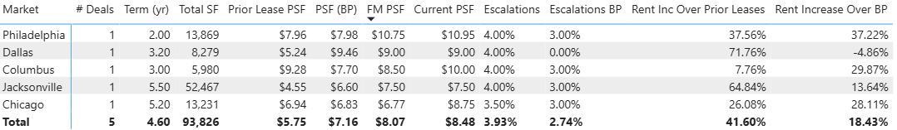
Q1 2025 | Market Level Summary – Fund 2
Fund 2 achieved a 42% leasing spread in Q2, surpassing the overall portfolio at 29%. Escalations outperformed business plan target of 2.74%, achieving 3.93% for the quarter.
1. Deals represent executed leases with term > 12 months​
2. Rent Increase over Prior Lease calculation excludes spaces that were previously vacant​

Slide 22
Downtime Quarterly Trend | Fund 2
Fund 2 downtime is exceeding UW DT only slightly as of Q2-2025 due to a drag created by long standing vacancies.
Current vacancies have been sitting an average of 8.0 months, above the underwritten 7.9 months.
*”Months to lease” – pulled from CoStar (7/25/25) for industrial properties 20-200KSF in FP markets

Slide 23
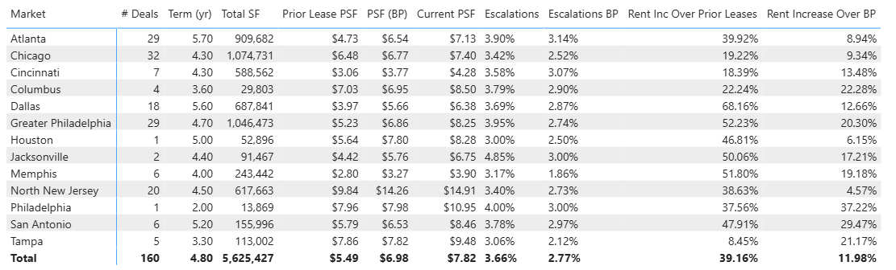
Leasing Performance since Inception | Fund 2 Stats
Leasing spreads during the quarter outpaced historical performance at 42%.
Renewal Rate has been 68% over the last year, in line with the overall portfolio. This last quarter renewal rate dropped to 17%, though this only represented six tenants.
Executed leases for the quarter have an escalation about 120 bp higher than UW assumption (2.74% UW vs 3.93% executed).

Slide 24
Quarterly Trend | Fund 2 Leasing Spreads Achieved
Fund 2 lease executions were approximately 5% above forecast manager in Q2 and 18% above business plan.
Fund 2 continues to execute leases at rates above the prior lease with a 42% leasing spread achieved in Q2.

Slide 25
Q2 2025 | External benchmarking
Lease escalations based on FP lease table; other metrics pulled from CoStar (7/25/25) for industrial properties 20-200KSF in FP markets

Slide 26
Portfolio Trends

Slide 27
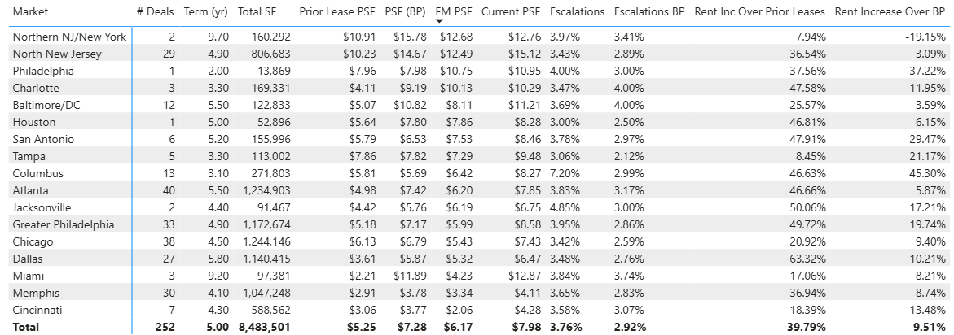
Leasing Performance since Inception | Overall Portfolio Stats (Fund 2 & 3)
252 Leases signed since inception with a Wtd. Avg. Rate of $7.28 and Wtd Avg. Term of 5.0
Leasing Activity achieved a spread of 40% over prior leases and 10% over Business Plan
New Leases achieved a higher rate spread over Business compared to Renewals. However, when adjusted for below market fixed option renewals, Rexy comparisons disprove a renewal bias.

Slide 28
Quarterly Trend | Portfolio Leasing Spreads Achieved (Fund 2 & 3)
Faropoint leasing activity to date has achieved an average ~40% spread over prior lease rates, and ~10% spread over Business Plan.

Slide 29
Portfolio Downtime since Inception | How is actual Downtime trending?
74% of signed new leases since inception in both funds have a downtime < 6 months.
~22% of signed new leases since inception exceeded UW downtime.
28% of the leases that exceeded UW downtime occurred in the past year.
The data set represents ~132 new leases signed since inception.

Slide 30
Tenants Lost | Impact on Renewal Rate (Fund 2 & Fund 3)
The past quarter saw a total of 17 tenant move-outs, of which 11 were in Fund 2, across markets, varying in size ranges.
One of the move outs was a result of a business closure/financial difficulty and one was the result of an eviction, both in Fund 2

Slide 31
AR (Operational Overview)

Slide 32
Fund 2 | Tenant AR Summary
How are the tenants from Q1 trending?
Level 1 tenant 60+ balance predominately driven by 6001 Irwin (NJ) - PSEG’s prior year CAM, which is $88K and is anticipated to be collected
Level 2 tenants balance remains relatively unchanged and is comprised of 17-01 Pollitt (NJ) where Kyodo is disputing electric charges and Philadelphia Hardware’s, at 7 Mary Way (NJ), where the tenant is disputing management fees due to roof issues
Level 3 tenants balance went down. Black Walnut’s $88K 1Q25 60+ day balance was paid, and minimal tenants were added with large 60+ day balance in 2Q25
Level 4 tenants balance remains relatively unchanged predominately driven by Global Concentrate’s write off of prior $128K 60+ day balance & offset by new tenants
Level | Description
0 | Known Vacate
1 | Administrative
2 | Disputes
3 | Payment Plans/Watchlist
4 | Eviction / Past Tenant
New Activity emerging in Q1
2 new tenants added to the Level 4 default pool
CTL Global Inc in Chicago (11697 Grand) - TT terminated lease and is paying lease termination fee over 3 months; Natural LXD 4/30/2029; $0 60+ day balance
MAGIC SCREEN PRINT LLC, and RETRO VERT, LLC in Atlanta (4507 Mills) - executed an early termination agreement and will vacate end of July. Natural LXD 9/30/2027; $0 60+ day balance
2 new tenants added to the Level 3 payment plan pool
Will-Moor School of Gymnastics in Greater Philadelphia (2036 Briggs) - TT occupies ~15K SF and has requested a payment plan; $4K 60+ day balance
Tex Sun Shade in Texas (12150 Shiloh) - TT occupies 11K SF and had an NSF in June but does not have a major balance issue. $0 60+ day balance

Slide 33
Fund 2 | Level 4 Tenants
Detail of Level 4 Tenants
Status​ | Property​ | Tenant​ | Credit Score | SF​ | In-Place Rent​ | Q1 25 Risk​ | Q2 25 Risk​ | 0-60 Days Balance​ | 60+ Days Balance​ | Notes​
Active​ | 4000 Dan Morton Dr (xtxmorto)​ | TexPac Hide & Skin, LTD (t0000522)​ |  | 77,536​ | $4.20​ | 4​ | 4​ | $91,853 | $686,837 | LL has possession; Lawsuit filed and TT countersued LL. Continuing billings per legal and collection efforts have not been successful to date
Active​ | 220 Route 70 (xnj220r)​ | Simonik Transportation & Warehousing Group, LLC (t0001151)​ | 3 | 23,545​ | $8.75​ | 4 ​ | 4 ​ | $35,565 | $459,614 | Tenant filed for bankruptcy write-off pending. $12K has been received from Bankruptcy court. Landlord has possession of the suite.
Active​ | 220 Route 70 (xnj220r)​ | RPI Industries Inc. (t0000598)​ |  | 60,880​ | $6.97​ | 4 ​ | 4 ​ | $80,389 | $225,090 | Settlement for $240K to be amortized into new lease anticipated to be executed week of 5/27/25. TT downsizing at property and upon execution will likely be moved to the Level 3 pool. Collection anticipated for approx. $175K of this amount.
Active | 4450 Commerce Circle (xga4450c) | KJ's Discount Outlet LLC (t0001012) |  | 18,700 | $6.24 | 3 | 4 | $28,831 | $53,483 | Apollo TT; Tenant terminated lease effective June 2025
Active | 4290 Delp Street (xtndelp1) | KPower Global Logistics, LLC (t0000638) | 4 | 63,840 | $3.79 | 3 | 4 | $28,808 | $20,075 | Tenant filed for bankruptcy and LL has been awared possession. AM working to remove tenant from suite
Active | 7550 North Crescent Blvd (xnj7550) | Flanagan's Towne Auto Enterprises III, Inc (t0000536) |  | 22,000 | $8.05 | 4 | 4 | $29,529 | $3,139 | Insurance event related
Active | 11697 W Grand (xil11697) | CTL Global Inc. (t0000767) |  | 48,340 | $5.86 | n/a | NEW 4 | $99,471 | $0 | Terminated lease and balance is for Leas Termination Fee (total $150K over 3 months). Natural LXD 4/30/2029
Active | 4507 Mills Place (xga4507m) | MAGIC SCREEN PRINT LLC, and RETRO VERT, LLC (t0001340) | 4 | 12,040 | $7.00 | n/a | NEW 4 | $445 | $0 | Early termination TT who will vacate end of July.
Past​ | Multiple​ | Multiple (5 Tenants) ​ |  | ​ | ​ | 4​ | 4​ | $29,001 | $4,200 | All tenants have moved out. Most of the balance is anticipated to be collected

Slide 34
Fund 2 | Level 3 Tenants
Detail of Level 3 Tenants
Status | Property | Tenant | Credit Score | Area | In-Place Rent | Q1 25 Risk​ | Q2 25 Risk​ | 0-60 Days Balance | 60+ Days Balance | Notes
Active | 2100 Boggs Road (xga2100b) | Averr Aglow, LLC (t0000639) |  | 103,289 | $6.96 | 3 | 3 | $1,716 | $32,644 | Apollo TT; Delinquent on personal property tax with county; prior CAM Cap Dispute has been agreed to and payment pending. TT formally noticed and is in default under the lease.
Active | 17-01 Pollitt Drive (xnj17pol) | Biogen Laboratory Corporation (t0000629) |  | 8,438 | $9.50 | 3 | 3 | $20,944 | $28,270 | Habitual Late Payer; Late fees/TBB likely not collectable in 60+. Renewal negotiations ongoing.
Active | 2036 Briggs Road (xnj2036b) | Will-Moor School of Gymnastics (t0000454) |  | 15,075 | $8.51 | n/a | NEW 3 | $33,639 | $4,235 | Tenant requested payment plan in July and paid ~$16K of this balance in July.
Active | 2036 Briggs Road (xnj2036b) | Kaizen Martial Arts of NJ (t0000452) |  | 5,025 | $7.48 | 3 | 3 | $0 | $3,175 | TT paid balance in July but NSF'd in May so continuing to monitor
Active | 6925 Sherman Ave (xnj6925s) | Aruvil International, Inc. (t0000784) |  | 30,000 | $5.78 | 3 | 3 | $986 | $693 | February payment NSF'd; issues with Commercial Café but monitoring. Will remove in 3Q25 if not futher AR issues arise. Only late fees open
Active | 19-05 Nevins Road (xnj19nev) | RD Foods America, Inc. (t0000627) | 5 | 151,799 | $15.25 | 3 | 3 | $60,388 | $0 | TT softness identified and has asked for rent defferment. July payment not received as of 7/17/25. AM escalating to file motion, TT assured they would be current by EOM in which case motion would be rescinded.
Active | 12150 Shiloh Road (xtx12150) | Tex Sun Shade (t0000701) | 5 | 11,436 | $9.17 | n/a | NEW 3 | $874 | $0 | June payment NSF'd; Difficult TT but no major balance issues. Keeping on watchlist for 2 quarters
Active | 250 North Washtenaw Avenue (xil250n) | Mighty Cake Company LLC (t0000608) |  | 46,000 | $9.90 | n/a | 3 | $19,854 | $0 | Apollo TT; Previously on a payment plan, this tenant refinanced and is saying they are in a better position. Open balance was paid in July. Keeping on watchlist for 2 quarters.
Active​ | 128 Bauer Drive (xnj128ba)​ | Black Walnut LLC (t0001074)​ | 3 | 21,142​ | $13.75​ | 3 | 3 | $0 | $0 | TT has become fully current and keeping on watchlist for 2 quarters.

Slide 35
AR Monitoring | Loan Pools
No Major Tenants are failing in Fund 2 Loan Pools from an AR perspective.
The Apollo Loan has 4 tenants that are being monitored
KJ's Discount Outlet LL (4450 Commerce) was previously on a payment plan and has since terminated their lease effective June 2025
Averr Aglow (2100 Boggs) has been upgraded to a Level 3 tenant because they are delinquent on their county personal property tax, a defaulting event under the lease. Open CAM cap dispute and has agreed to but payment remains is pending. Tenant has now been formally noticed and is in default under the lease.
Mighty Cake Company LLC (250 North Washtenaw Ave) has been on a payment plan and has refinanced and are saying they are in a better position. Open balance was paid in July. Keeping on watchlist for 2 quarters.
Lender | Property | Market | Lease | Area | Q2 25 Tenant Risk | 0-60 Owed | 60+ Owed | Total Owed
Apollo | 4450 Commerce Drive (xga4450c) | Atlanta | KJ's Discount Outlet LLC (t0001012) | 18,700 | 4 | $28,831 | $53,483 | $82,314
Apollo | 250 North Washtenaw Ave (xil250n) | Chicago | Mighty Cake Company LLC (t0000608) | 46,000 | 3 | $19,854 | $0 | $19,854
Apollo | 2100 Boggs Road (xga2100b) | Atlanta | Averr Aglow, LLC (t0000639) | 103,289 | 3 | $1,716 | $32,644 | $34,360

Slide 36
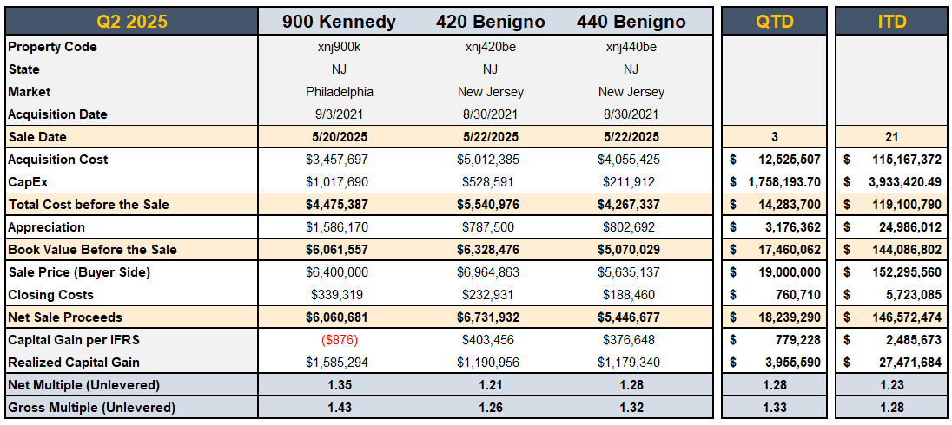
Disposition Activity Overview
Key Takeaways
QTD
In Q2 2025, completed the sale of 3 assets generating $18.2M net sale proceeds (after closing costs) received by the Fund:
900 Kennedy (NJ) - $6.1M Net Sale Proceeds
420 Benigno (NJ)- $6.7M Net Sale Proceeds
440 Benigno (NJ) - $5.4M Net Sale Proceeds
ITD
Inception to date, completed the sale of 21 assets generating $147M net sale proceeds (after closing costs) received by the Fund:
Realized Gain (Net Proceeds – TC) = $27.5M
Gross Multiple (Unlevered) = 1.28
Net Multiple (Unlevered) = 1.23
Impact on Fund NAV
Property Dispositions impact the Fund on 4 Levels throughout the quarter:
Cash: The property sales generated $18.2M in net sale proceeds received by the Fund.
Debt Availability: Selling the properties improves our availability, but not by the full $18.2M since the NOI used for the availability calculation decreases due to the sales.
Capital Statement: From an IR perspective, $3.2M appreciation (unrealized gain) was previously recognized on the P&L in accordance with the IFRS Fair Value accounting.
Given that the realized Capital Gain from the sale is $4.0M, upon disposition we increased our IFRS realized capital gain in the books by $779K realized gain.
Tax: The dispositions created a capital gain at the Fund-level. The gains will be offset by ongoing losses at the Fund-level for 2025 income tax reporting.

Slide 37
Financial Overview

Slide 38
Balance Sheet
Key Takeaways
Fund Reserves
Fund Reserves = Net Current Assets + Credit Facility Availability
Q2 Results: Q2-25 Fund Reserves of $66M, decrease of $1M from the Q1-25 Fund Reserves of $67M – after reducing revolver commitment to $50 ($150M in Q1)
Cash: $15M in JPM at a ~3.5% yield, pending distributions
Investments in Real Estate
FMV: $1,240M as of Q2-25 (TC of $1,013M) - represents 22.4% unrealized MTM
Dispositions:
QTD -> 3 dispositions, $18.2M Net Sale Proceeds ($4.0 Capital Gain)
ITD -> 21 dispositions, $146.6M Net Sale Proceeds ($27.4M Capital Gain)
Q2 Appraisals: In Q2-25, 46 properties were appraised at $258.6M, compared to $256.5M book value, representing 1% in unrealized appreciation for this sub-set over book value
Derivative Instruments
FMV: $2.6M as of Q2-25, down from $4.1M in Q1 reflecting change in SOFR forward curve
Hedge Ratio = 87.5%
A/R Tenants, Net
$1.3M A/R Tenants, Net of Allowances, as of Q2 2025 ($1.2M as of Q1 2025)
(see following slides for analysis)
Debt, Net of Deferred Financing Costs
$484M loans ($371.5M KeyBank and $112.5M Apollo), less $2.9M of financing costs
WA LTC: 47.8% as of Q2-25 (48.2% as of Q1-25)
Equity Upside
Gross TVPI = 1.70x (1.68x Q1); Net TVPI = 1.54X (1.52x Q1)
Gross IRR = 17.1% (18.0% Q1); Net IRR = 13.4% (14.0% Q1)
1
2
3
1
2
3
4
4
5
5
*Note: Promote liability is presented as of Q1-25 balance, as the Q2-25 promote is not yet approved.
Notes:
d

Slide 39
Profit and Loss
Key Takeaways
1
Net Operating Income
Increase of $0.4M in NOI during the quarter (as projected based on budget)
Overall, YoC has increased to 5.7% (compared to YoC of 5.5% in Q1-2025)
G&A:
G&A expenses were around ~62bps of equity, consistent with prior quarters
According to our analysis, we project 2025 G&A at ~65bps out of equity ($500)
Other One-Time Income, Net
Q2 2025 - $800K termination fee, $2M insurance proceeds (3857 Miller Park)
Q1 2025 - $600K termination fee, $300K insurance proceeds (3857 Miller Park)
Change in Fair Value of Investment Property
46 Properties appraised, $2.9M MTM adjustment for the quarter for this sub-set
Interest Expense, Net
Base Interest Rate = 5.34% in Q2-2025, 7bp increase from 5.27% in Q1-2025
Effective Interest Rate = 5.95% in Q2-2025, 6bp increase from 5.89% in Q1-2025
*Adjusts for unused fees, financing and interest rate cap amortization costs, etc.
Hedge Ratio = 87.5%
Change in Fair Value of Derivative Instruments, Net
Change in FMV went down because the forward SOFR curve decreased and the time to expiration decreased, therefore decreasing the value of the derivatives
2
3
1
2
4
3
5
4
6
5
6
Notes:
Q2-2025
Insurance Proceeds $2.2M
3857 Miller $1.9M
7550 N Crescent $225K
Termination Fee Income $800K
9330 Industrial Trace - $591K Myers Tire Supply
11697 W Grand - $150K CTL Global
4000 Dan Morton - $50K TexPac (legal settlement)
1980 Old Cuthbert - $20K Ribbons Express
Q1-2025
Insurance Proceeds $280K
3857 $380K
Termination Fee Income $690K
1211 Ford - $420K Northeast Building Products
19 Industrial - $135K OEM Accessories
1980 Old Cuthbert - $20K Ribbons Express
6704 N 54th Street - $110K Don’s Automotive Supply

Slide 40
Properties NOI Actuals vs. Budget
Key Takeaways
1
Overall, Q2-2025 NOI was above budget, primarily due to higher base rent and bad debt recoveries.
Base Rent
Four tenants drove most of the positive variance:
Amphenol EEC (170 Birchwood), Economy Tire (11839 Shiloh), and Werner Aero Services (19 Industrial Avenue) continued paying full base rent despite budget assumptions of no rent, reflecting lease renewals.
Black Walnut (128 Bauer) paid more than budgeted base rent after resolving prior delinquencies.
Other Income
The entire variance in other income was due to late fee revenue
Operating Expenses Operating Expenses came in above budget, due to:
$150K in utilities related to a tenant billback (already reimbursed and included in additional rent).
Approximately $150K of non-recoverable repair and maintenance expenses.
Bad Debt Expense
Recoveries from previously reserved receivables reduced bad debt expense:
RPI Industries: $175K to be collected under a new lease.
Global Concentrate: ~$155K recovered.
Jack Daniels Motors: ~$74K recovered.
2
1
2
3
3
4
4
* Budget column represents 2025 property-level budgets, includes all properties owned by the Fund as of end Q1-2025
Notes:
Q2 2025
Operating Expenses
Utilities
This variance is mainly due to a $200K tenant billbacks.
4290 Delp $69K for plumbing expenses
17-01 Pollitt Drive $41K in electric expenses.
220 NJ-70 $35k for multiple utility expenses.
Non-Recoverable Expenses:
Building R&M
3857 Miller Park Drive: property demolition ~$95K (Capex?)
Non-Recoverable
6000 Irwin Road: Fire Protection ~$46K

Slide 41
Same Store Analysis
Key Takeaways
1
Overall
Same Store NOI increased ~$0.4M mainly due to bad debt recovery in Q2 2025, compared to Q1 2025
Base Rent
Consistent QoQ, in line with decrease in occupancy
Concessions
Tenants (19-05 Nevins Road) vacated in current quarter were a large % of Concessions in prior quarter
Operating Expenses
Consistent QoQ, R&M connected to vacated properties
Bad Debt Expense
$475K Recoveries of previously written off A/R
1) RPI Industries $175K to be recovered in new lease
2) Global Concentrate ~$155K recovered
3) Jack Daniels Motors ~$74K recovered
2
1
2
3
3
4
4
*Physical Occupancy adjusts for Leases pending Yardi Terminations - Includes all properties owned by the Fund as end of Q1-2025
Notes:
Q2 2025: xnj19nev biggest concession falloff

Slide 42
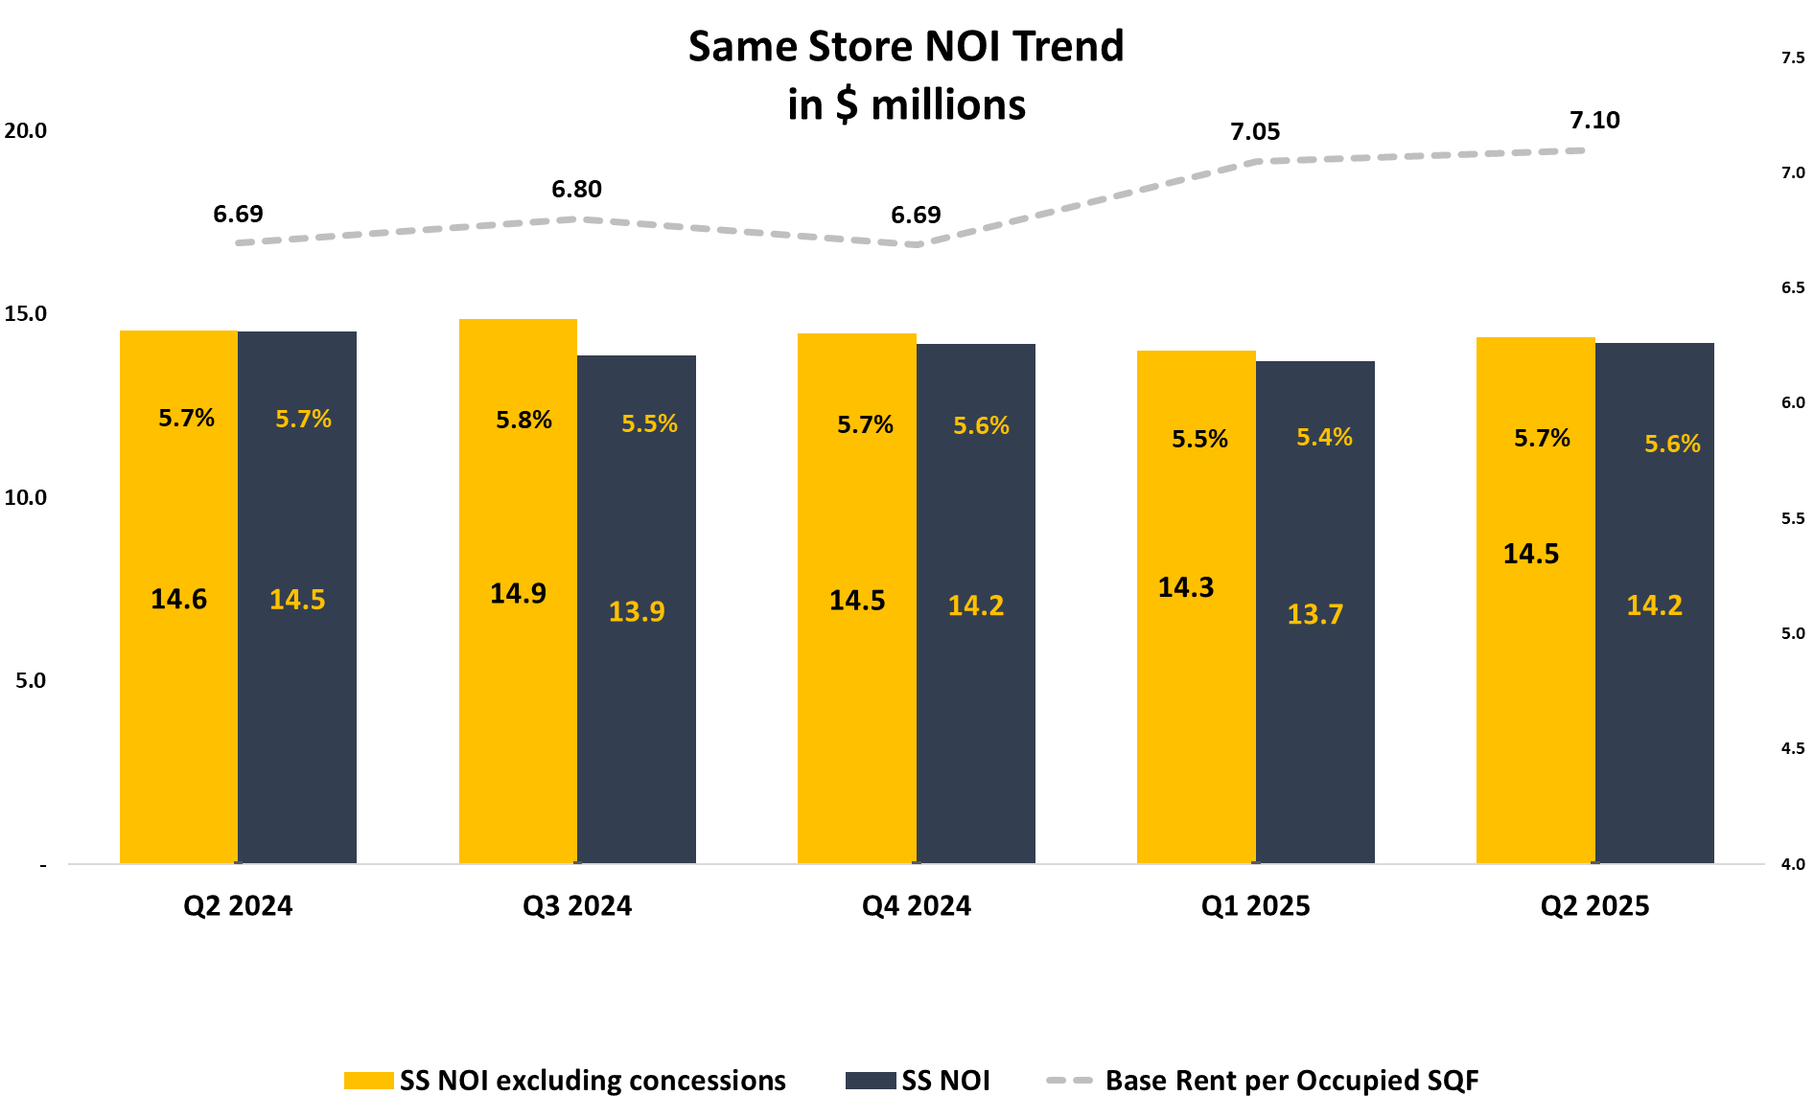
Same Store Analysis - QoQ Trend
Key Takeaways
Q2 Same Store NOI
Same store NOI increased in Q2, primarily driven by successful bad debt recoveries.
Same Store NOI – Yearly Trend
Over the past year, same store NOI remained stable, as higher leasing spreads were offset by a decline in occupancy.
Importantly, base rent per occupied square foot grew by 6%, rising from $6.70 to $7.10, reflecting the strength of our leasing execution.
94.4%
92.4%
89.5%
88.3%
87.2%
Adj. Physical Occupancy*
*Note:
Physical Occupancy adjusts for tenants who are in spaces but not currently paying prior quarters.
SSNOI was adjusted to reflected the fair share of the Cam Reconciliation for the period.

Slide 43
Fund Performance – Non-GAAP KPIs
Key Takeaways
Core FFO increased this quarter to 3.6%, primarily driven by higher NOI.
Core FFO was impacted by the following:
G&A
G&A expenses were around ~62bps of equity
According to our analysis, we project 2025 G&A at ~65bps out of equity ($500)
Payout Ratio
According to the loan agreement, we include realized capital gains and exclude non-cash expenses such as financing costs amortization in the analysis
Feeder-Level Expenses
Defined as additional G&A expenses specifically allocable to feeder entities not reflected in Fund-level G&A (e.g., REIT Compliance, Cayman feeder regulatory compliance, etc.)
~10bps – ~20bps on equity / year
No impact to Core FFO, but will reduce the amount of distributable proceeds as costs will not be recouped until future periods
* Prior quarters results were adjusted to reflected the fair share of the Cam Reconciliation for the period.

Slide 44
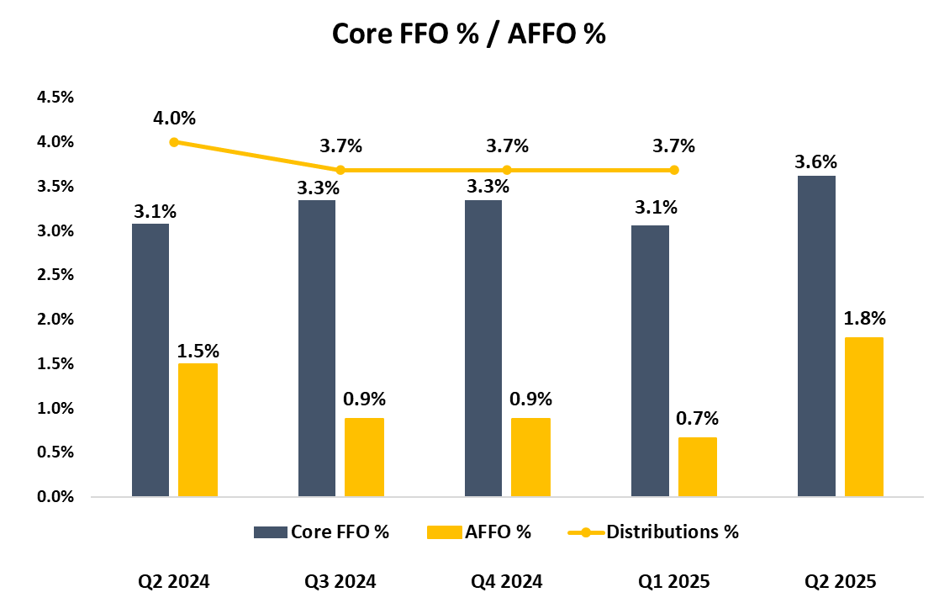
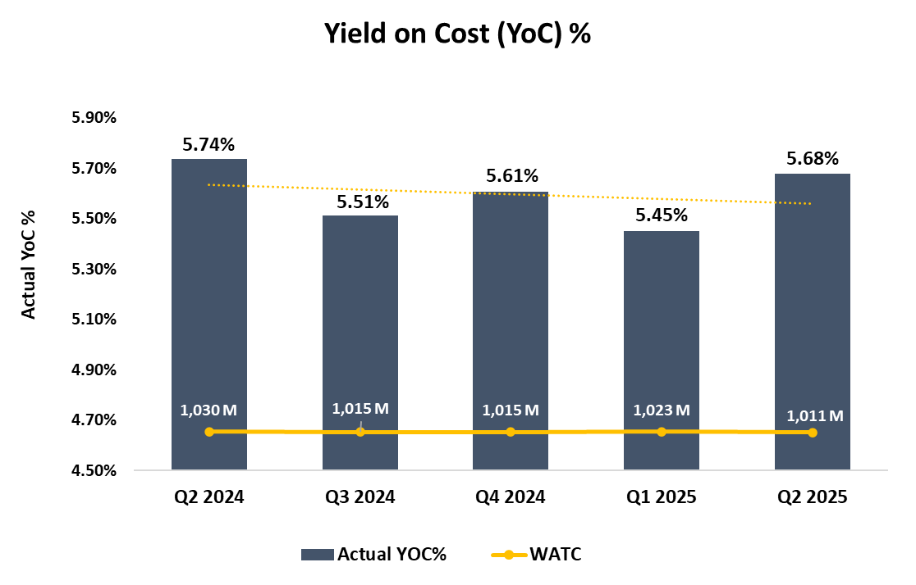
Fund Performance – Non-GAAP Financial Measures
Key Takeaways
Q1 2025 → Q2 2025 Trend: Yield on Cost (YoC%) increased QoQ, reflecting 5.68% as of Q2-2025 compared to 5.45% as of Q1-2025 Core FFO increased QoQ, due to higher NOI driven by higher additional income and lower concessions | Forecasted Trends: As the Fund’s debt is either fixed or hedged at 87.5%, our interest rate risk exposure is underhedged compared to previous quarters We anticipate future property performance improvements to continue to positively impact Core FFO Distributions in excess of Core FFO was funded through T12 capital gains. In order to keep distribution pace, additional dispositions are necessary
Prior quarters YoC%/FFO/AFFO was adjusted to reflected the fair share of the CAM Reconciliation for the period.

Slide 45
Distributions Considerations
Consideration/Suggested Amount | Core FFO + Capital Gain+One Time income ($12 M / 9.6%)
IRR | Boosts IRR without taking additional risk
Consistency | One-off event; won’t align with prior quarters. Communicate as special distribution tied to realized gains.
Availability Forecast: Base Case vs. Stress Test | In our stress case, the debt availability is forecasted hits a low point of +$6M in Q2 2026 with no dispositions or refi, but it remains at +$45M in the base case (with no refi). These forecasts assume a $12M distribution this quarter
Payout Ratio | Supports payout-ratio test when including Capital Gains.
Taxes (PIE) | • Helps pay accrued shareholder-loan interest.

Slide 46
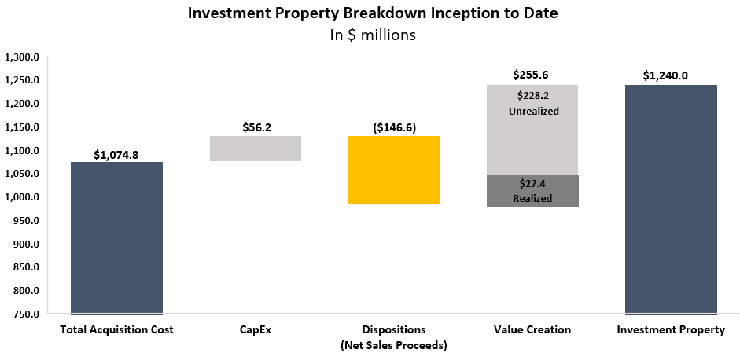
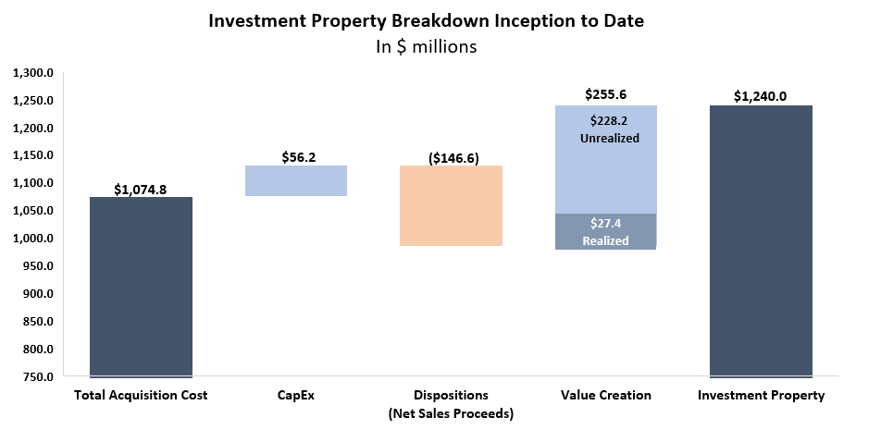
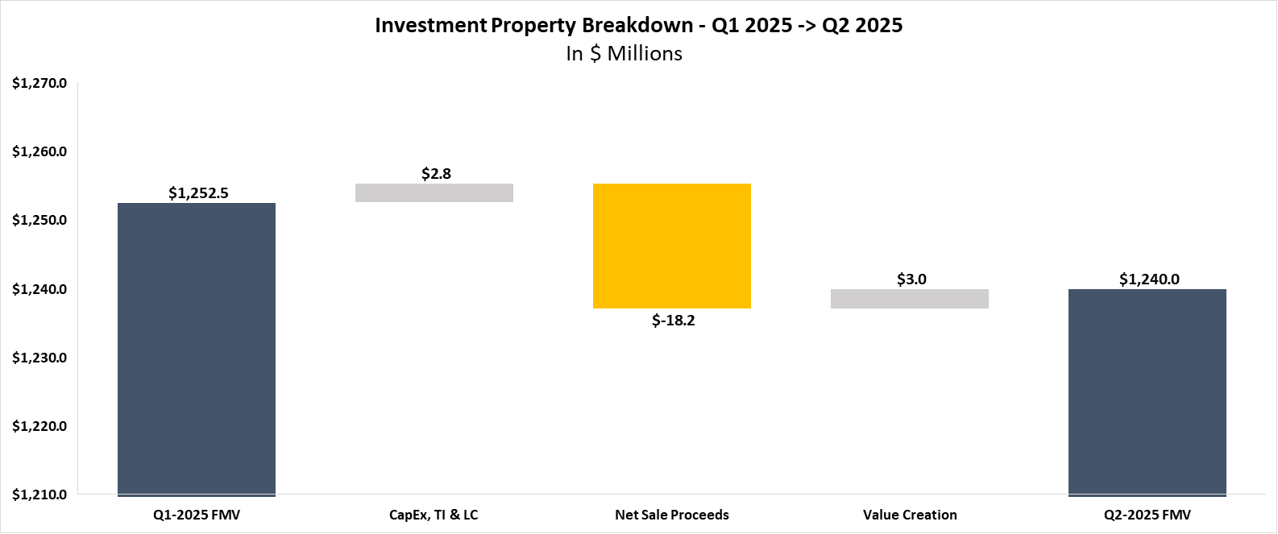
Valuation Summary – Q2 2025
Key Takeaways
Value creation inception to date has resulted in a +22.4% increase in fair market value vs. total cost (purchase price + closing costs + capex + dispositions) Since Inception, the fund has incurred a total of $13.7M in closing costs related to the acquisition of the properties. These closing costs have partially offset the overall value creation amount over the specified period All of the Fund’s properties were appraised at least once | During Q2-25, 46 properties were appraised for a total appraisal value of $258.6M The Q2-25 value creation of approximately $2.2M represents appraisal mark-to-market (representing 1% in unrealized appreciation for this sub-set over book value)

Slide 47
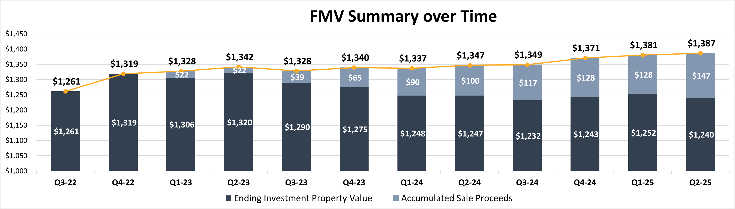
Valuation Summary – FMV Summary over Time ($M)

Slide 48
Same Store Analysis – Market Comparison
Still need to provide more context and commentary
*Note:
- Physical Occupancy adjusts for tenants who are in spaces but not currently paying prior quarters
- Includes all properties owned by the Fund as of Q1-2025
Notes:
Q2 2025:

Slide 49
Same Store Analysis – Market Comparison
Still need to provide more context and commentary
*Note:
- Physical Occupancy adjusts for tenants who are in spaces but not currently paying prior quarters
- Includes all properties owned by the Fund as of Q1-2025
Notes:
Q2 2025:

Slide 50
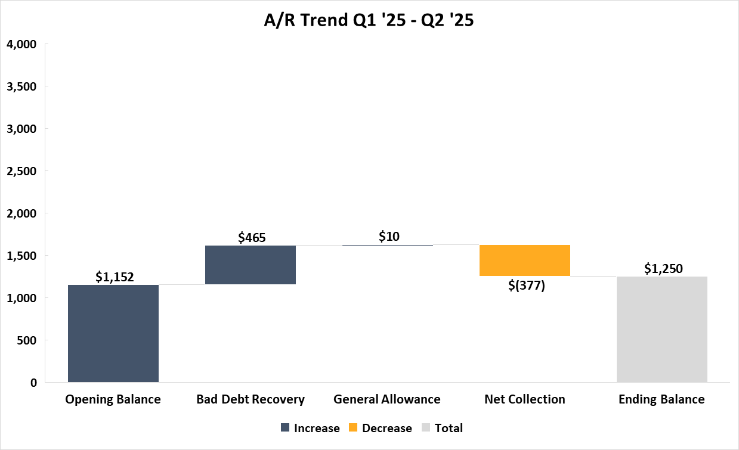
AR Trend Summary Q1 ‘25 -> Q2 ’25
Key Takeaways
Net AR Balance increased by $100K during Q2 2025
Bad Debt Recovery:
The Bad Debt Recovery is composed of Actual Write offs and specific bad debt allowance
Two highest AR collections (RPI Industries and Global Concentrate) netted ~$0.35M
General Allowance
Calculated in accordance with the General Allowance methodology, slight decrease in line with the overall decrease in AR balance QoQ
Net Collections
Significantly smaller than in prior quarter; final A/R slightly higher than previous quarter
1
1
2
2
3
3

Slide 51
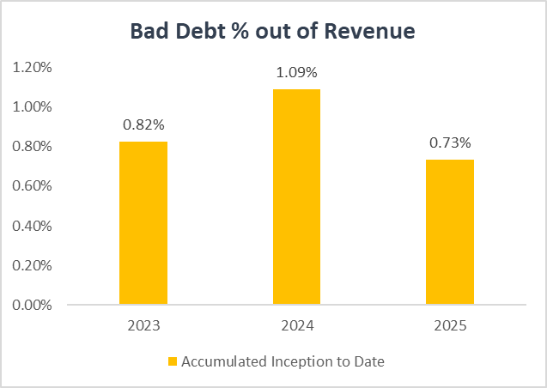
Bad Debt % out of Revenue
Key Takeaways
As of the end of Q2 2025 we have observed a decrease in bad debt from the peak in 2024. So far in 2025 we were able to recover amounts that had been written off in the past.
Historically, particularly in 2021 and 2022, there were instances where, instead of recording bad debt, revenue was reversed at the property level. The chart is based solely on the "bad debt expense" recorded in the books.
Notes:
ITD -> accumulated; add comments to key takeaways

Slide 52
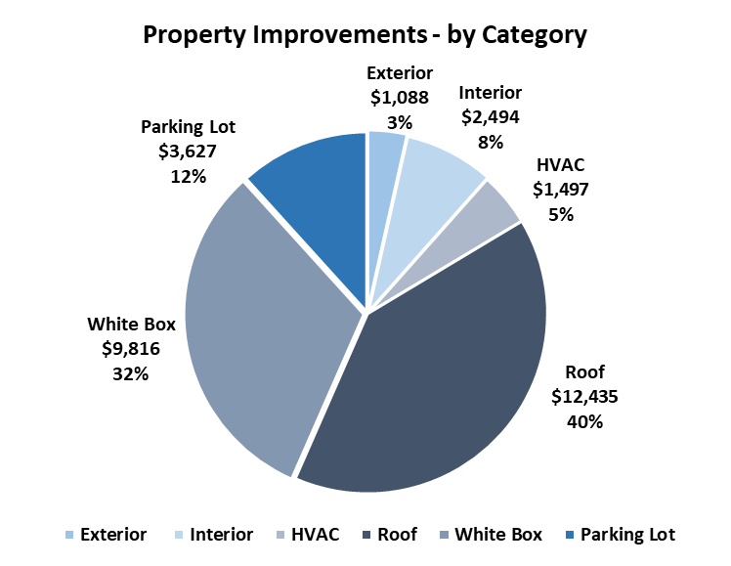
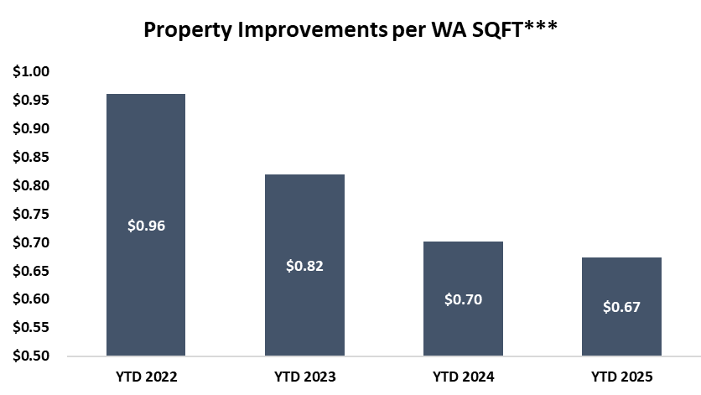
CAPEX, Tenants Improvements & Leasing Commissions
Key Takeaways
Q2 2025
$2.8M CapEx invested, representing 19.6% of NOI and $0.60/sqft for the quarter
Inception to Date
$57.1M CapEx invested, representing 28.9% of accumulated NOI
45 properties have had roof replacements, totaling ~10.4M
Comparison to UW
$7.6M CapEx invested compared to the initial underwriting data provided by the Construction team
*Property Improvements include non-recoverable CapEx and CM Fees.
**Turnover Costs represent the estimated obligations incurred in connection with the signing of a lease; including leasing commissions and tenant improvements.
***Property Improvements per WA SQFT is calculated as Property Improvements for the period divided by the WASF (weighted average square footage) for the period.

Slide 53
Main Debt Covenants Overview
Loan | Covenant | Threshold | NOI Basis | NOI Adjustments | Q2 2025 Metric | YoC %* | Occupancy
Apollo | Debt Yield | 8.75%, 9.00%, 9.25% | T12 | 5% Vacancy / Credit Loss | 9.04% | 5.81% | 87.6%
KeyBank – Collateral Pool | Implied DSCR | 1.30x | T12 | $0.15 SF / AR 60+ / Other Income | 1.55x | 5.79% | 90.4%
 | Availability |  |  |  | $50M
KeyBank – Fund Level | FCCR | 1.50x | T12 | N/A | 2.01x | 5.43% | 87.6%
*Note:
- Yield on Cost (YoC %) calculated based on trailing-12 months adjusted NOI (T12 NOI, less: non-recurring other income and A/R +60 days outstanding
- Non-recurring other income is comprised mainly of insurance proceeds and termination fee income

Slide 54
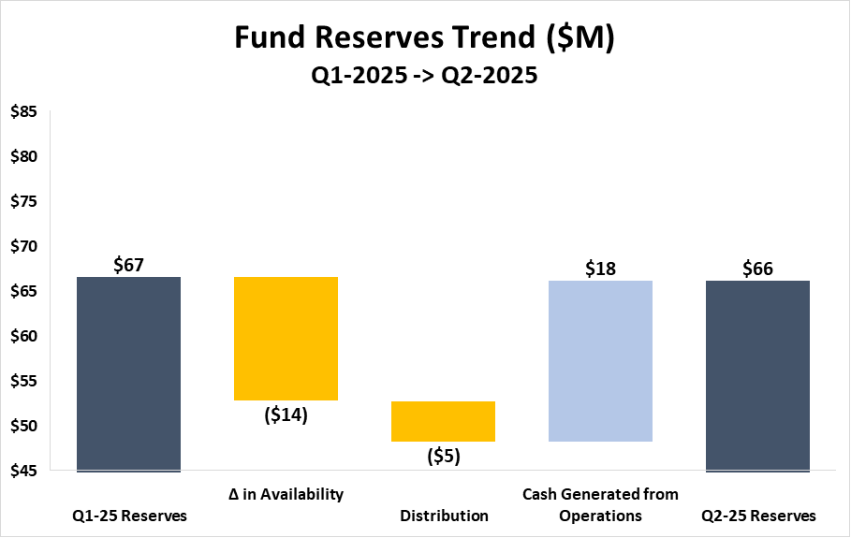
Fund Reserves
Key Takeaways
FCCR = 2.01x
Fund Reserves = Net Current Assets + KeyBank Credit Facility Availability
Net Current Assets = Current Assets – Current Liabilities (including security deposit liabilities on leases coming due in <12 months)
Key Drivers Impacting Fund Reserves during the Quarter:
(-) 10Y Treasury Rate:
KeyBank Availability calculation models the Implied DSCR based on the T12 10-Year Average Treasury rate. As of Q2-2025, there was a 4-basis point (bp) decrease in the trailing twelve-month (T12) 10-Year Average Treasury QoQ:
Q2 2025 T12 10YT Average = 4.24%
Q1 2025 T12 10YT Average = 4.28%
(-) Distributions:
$4.6 million distribution to investors during Q2 (3.7% Cash on Cash)
(+) Cash Flow Generated from Operations:
Includes $2.2M AFFO for Q2-2025, as well as additional cash collections in excess of billings for the quarter (bad debt recoveries, termination fee income, etc.).
It's important to note that most of the bad debt expenses for this quarter were already excluded from the availability calculation due to the loan agreement, which excludes AR +60 days.

Slide 55
G&A Breakdown – Q2 2025
Key Takeaways
2025 Projected G&A is ~65bps, excluding management fees & feeder expenses
Most expenses are non-controllable expenses
Audit Fees – based on 2025 engagement letter with KPMG
Tax Compliance Fees – based on 2025 engagement letter with EY
Administrator Fees – based on 2025 engagement letter with EA RESIG
Valuation Fees – based on 2025 engagement letter with JLL ($2K/appraisal)
Legal & Professional Fees – run rate based on historical data
Property-Level – collections litigation, lease negotiations, RE tax advisory, tenant credit checks, etc.
Yardi Software – per the annual agreement
Other Software – run rate based on historical data
Management Fees – run rate based on historical data
Feeder Expenses – run rate based on historical data (~10bps - ~20bps on equity)

Slide 56
Insurance Proceeds - Deep Dive
Since the Fund's inception, $9.3 million insurance proceeds were collected. The impact on the financial statements and various KPIs is shown below:
Audited Financial Statement | FPR | KeyBank Covenant Calculation
Included in Net Income | Excluded from Non-GAAP KPIs (FFO/NOI) | Excluded in NOI, Included in EBITDA
In the audited financial statement, termination fees will increase both the fund's revenue and net income As a reminder, Non-GAAP KPIs like NOI and Core FFO are not presented in the audited financial statement | The internal KPIs are based on management's definitions and are not governed by IFRS or US GAAP Since termination fees are a one-time income, they will be excluded from Core FFO and NOI However, in cases where the termination fee compensates for loss of income, the relevant amount may be included in the non-GAAP KPIs, as determined by management | Under the credit agreement definition, termination fees are excluded from NOI in the Implied DSCR test for availability determination However, per the credit facility agreement, termination fees will be included in Consolidated EBITDA (base for FCCR Test) since the fees are recognized as revenues included in net income in the audited financial statements
Revenue Recognition: Revenue from insurance proceeds will be recognized only when the amount is fixed or determinable, and collection is reasonably assured—typically estimated at a minimum of 80%. This requires that any contingencies related to the claim are resolved, with evidence from the insurer indicating either an intent to pay or an approval of the claim.

Slide 57
Termination Fee - Deep Dive
Since the Fund's inception, $1.6 million termination fees were collected. The impact on the financial statements and various KPIs is shown below:
Audited Financial Statement | FPR | KeyBank Covenant Calculation
Included in Net Income | Excluded from Non-GAAP KPIs (FFO/NOI) | Excluded in NOI, Included in EBITDA
In the audited financial statement, termination fees will increase both the fund's revenue and net income As a reminder, Non-GAAP KPIs like NOI and Core FFO are not presented in the audited financial statement | The internal KPIs are based on management's definitions and are not governed by IFRS or US GAAP Since termination fees are a one-time income, they will be excluded from Core FFO and NOI However, in cases where the termination fee compensates for loss of income, the relevant amount may be included in the non-GAAP KPIs, as determined by management | Under the credit agreement definition, termination fees are excluded from NOI in the Implied DSCR test for availability determination However, per the credit facility agreement, termination fees will be included in Consolidated EBITDA (base for FCCR Test) since the fees are recognized as revenues included in net income in the audited financial statements

Slide 58
Fund Forecast

Slide 59
Full Fund Forecast

Slide 60
Fund Forecast | Overview of Fund Timeline
Key Takeaways
The Fund Initial Closing was in April 2021 with an initial fund term of 6 years with two 12-month extensions (6+1+1)
The Fund is currently in DD for a ~$273M Refinance of 61 Properties with JPM & CONA expected to close in September
We are here
May ’26
Revolver Expires ($50M Committed)
Dec ’26
TL A Expires ($104M)
Jun ’27
TL B Expires ($267.5M)
Feb ‘28
Feb ‘29
Apollo Loan Open ($112.5M)
Dec ‘21
Dec ‘22
Dec ‘23
Dec ‘24
Dec ‘25
Dec ‘26
Dec ‘27
Dec ‘28
Apr ‘21
Apr ‘24
Oct ‘24
Apr ‘25
Apr ‘27
Apr ‘28
Apr ‘29
Initial
Close
End of 3 Year Inv. Period
+6 Months Extension
+6 Months Extension
End of 6 Year
Fund Term
+1 Year
Extension
+1 Year
Extension

Slide 61
Fund Forecast | Identified Dispositions
Key Takeaways
There have been 21 dispositions in the fund to date, with a total sales price of ~$151.3M
The model assumes 24 dispositions in the future totaling ~$151.8M of sales price, largely misfits with quality or location issues
Forecasted Dispositions
Period | Sales Price | Area (SF)
Inception to Date | $151.3M | 1.7M SF
Forecasted | $151.8M | 1.8M SF
Total | $303.1M | 3.5M SF

Slide 62
Fund Forecast | Identified Dispositions
Update
Key Takeaways
There have been 21 dispositions in the fund to date, with a total sales price of ~$132.3M
The model assumes 12 dispositions in 2025 totaling ~$68.8M of sales price, largely misfits with quality or location issues
The Investments Team has identified an additional 12 assets for disposition in 2026 and on, those are not modeled here
Forecasted Dispositions
Actual & Forecasted Dispositions
Asset Name | Area (SF) | Sales Price | Disposition Date
420 Benigno Boulevard | 53.1k | $7.1M | 5/31/2025
440 Benigno Boulevard | 42.9k | $5.7M | 5/31/2025
900 Kennedy Boulevard | 41.5k | $6.4M | 5/31/2025
6900 River Road | 22.7k | $3.1M | 6/30/2025
1211 Ford Road | 106.0k | $12.5M | 7/31/2025
3350 Hamilton Boulevard | 86.5k | $8.1M | 7/31/2025
4728 Goldfield Drive | 77.7k | $10.1M | 7/31/2025
1000 E 87th St* | 34.3k | $2.1M | 8/31/2025
3040 - 3050 E 14th Avenue | 11.5k | $1.3M | 10/31/2025
3045 - 3065 Switzer Avenue | 17.9k | $2.1M | 10/31/2025
1149 - 1161 Rarig Avenue | 28.8k | $3.3M | 11/30/2025
3000 - 3004 E 14th Avenue | 61.9k | $7.1M | 11/30/2025
Total | 585.8K SF | $68.8M
Period | Sales Price | Area (SF)
Inception to Date | $132.3M | 1.6M SF
Q2 2025 | $22.3M | 160.2K SF
Q3 2025 | $32.7M | 304.6K SF
Q4 2025 | $13.8M | 120.1K SF
Total | $201.1M | 2.2M SF
*Sale Price derived from Q2 2025 FMV

Slide 63
Fund Forecast | Yield on Cost Trends
Key Takeaways
Significant 89bps (i.e., 15.9%) growth to yield on cost projected in 2026
Projections below reflect an adjusted NOI factoring in a bad debt assumption of 2% H2 2025 – H1 2026 and 5% thereafter
Projections below reflect Forecast Manager (FM) book closed in July 2025

Slide 64
Fund Forecast | Capex, TI & LC Trends ($M)
Key Takeaways
CapEx fluctuates over time, with it peaking in 2026 at $8.7M
Accumulated CapEx and TI/LC reach ~$93.3M for the fund by the end of 2027

Slide 65
Loan & Hedging Maturities
Floating
Executed Hedging
Loan Term
Floating
$11.5M
4.3% + 2% = 6.3%
Hedging Overview
Cap
$140M
3.0% + 2% = 5%
Mar ‘22
Apr ‘25
Swap
$150M
2.74% + 2% = 4.74%
May ‘22
Dec ‘26
Expired 4/16/25
Swap
$50M
2.92% + 2% = 4.92%
Jun ‘22
Dec ‘26
Swap
$30M
3.60% + 2% = 5.60%
Mar ‘23
Jun ‘27
Fwd Swap
$95M
3.26% + 2% = 5.26%
Apr ‘25
Jun ‘27
Apollo
$112M
Feb ‘24
Feb ‘29
Term Loan B
$267M
Jun ‘22
Jun ‘27
Credit Facility Term Overview
Avg. of ~200bps spread
Term Loan A
$104M
Dec ‘21
Dec ’26
Revolver
$150M
$0M Outstanding
May ‘21
+1
+1
May ‘26
Dec ‘21
Dec ‘22
Dec ‘23
Dec ‘24
Dec ‘25
Dec ‘26
Dec ‘27
We are here – July ‘25

Slide 66
Fund Forecast | Hedging Overview after Refi
Key Takeaways
In Q2 2025, our weighted average hedging was 90%
We have $95M of forward swaps that are now effective as of Q2 2025 to account for the expiration of the $140M cap in April 2025
We expect to close on a $273M refi in September at SOFR + 170 bps for which we will enter a swap for 3-4 years
To maintain REIT compliance, some hedging will have to be sold upon the refi to prevent fund from being over hedged after future property dispositions
The forecasts here factor in the future property dispositions
$200M in swaps expire 12/16/26
$20M swap sold Q3-24
$140M cap expired 4/16/25
$273M hedged refi brings fund over 100% hedged if no action is taken
Note: All-in interest rates and % hedged graphs represent weighted averages throughout each year
SOFR forward curve taken as of 7/23/2025

Slide 67
Fund Forecast | Effective Hedging Analysis
Dec 2026:
$104M TL A Expires
Jun 2027:
$267M TL B
Expires
Key Takeaways
We are tracking to be above our hedging target in each quarter until Q1 2027 when $200M in swaps expire
We already have $95M of forward swaps in place to account for the expiration of the $140M cap in June 2025
The hedging trend remains above 90% throughout 2025 as the cap expiration is offset by $68.8M of dispositions and the $95M in forward swaps commencing
May 2026: Revolver Expires
$140M cap expired 4/16/25
$200M in swaps expire 12/16/26
In-Place Hedging | Type | Amount | Rate | Start Qtr | End Qtr
$112.5M Apollo Refi – 5 Yr | Refi | $112.5 | 3.94% | Q1 2024 | Q1 2029
$140M Cap - 3 Yr | Cap | $140 | 3.00% | Q2 2022 | Q2 2025
$150M Swap - 5 Yr | Swap | $150 | 2.74% | Q2 2022 | Q4 2026
$50M Swap - 5 Yr | Swap | $50 | 2.92% | Q2 2022 | Q4 2026
$50M Swap - 4.25 Yr | Swap | $30 | 3.60% | Q1 2023 | Q2 2027
$50M Fwd Swap - 2.13 Yr | Swap | $50 | 2.79% | Q2 2025 | Q2 2027
$15M Fwd Swap - 2.13 Yr | Swap | $15 | 4.26% | Q2 2025 | Q2 2027
$15M Fwd Swap - 2.13 Yr | Swap | $15 | 3.80% | Q2 2025 | Q2 2027
$15M Fwd Swap - 2.13 Yr | Swap | $15 | 3.29% | Q2 2025 | Q2 2027

Slide 68
Fund Performance Overview | Quarterly FFO & AFFO Forecast
Key Takeaways
After refi in Q3, Core FFO will drop to $2.5-3.0M for the remainder of 2025. In 2026 after refi, the Fund projects to average $4.4M (or 3.5%) Core FFO
AFFO is negative in Q4 2025 and early 2026 due to significant CapEx, TIs, and LCs expected in those quarters

Slide 69
Fund Performance Overview | Distribution Forecast
Key Takeaways
Starting in Q3 25, we expect to maintain ~$12-16M distributions per quarter through the 2027. However, this is dependent upon restructuring the facility payout ratio covenant to allow for larger distributions
After the completing the $273M refi, we expect to be able to distribute an additional ~$75M of surplus proceeds to investors

Slide 70
Fund Performance Overview | IRR Forecast
Key Takeaways
With a recap at the end of this year, the Fund generates $32.3M of total promote. However, only $17.7M of this promote will be recognized in January, with a significant additional portion unlocked in 2026. This is driven by the Standard LPA investors being at only ~8% IRR after the recap and relying on the later 2026 dispos to reach the 100% catch-up tranche
The 2026 recap scenario assumes $70-75M of assets are sold after the recap throughout 2026
All scenarios set the next buyer to 16% Gross IRR, with the sale price dictated by the assumed exit cap for the next buyer
2026 Recap with Dispos Post Recap
End of Year 2025 Sale
Identified Dispositions & $273M Refi
End of Year 2027 Sale

Slide 71
Fund Forecast | Debt Covenants
Key Takeaways
With no dispositions and no refi, we are expected to maintain compliance with the FCCR in all quarters moving forward
In the refi, we assume that we distribute $75M back to investors and maintain ~$12-16M distributions per quarter (associated with restructured facility covenant). Even in this case, we have a minimum FCCR of 1.48x in the stress case
However, we aim to adjust or remove the FCCR covenant as part of the restructuring of the credit facility

Slide 72
Debt Availability and Distribution Forecast

Slide 73
Debt Availability Forecast | Base Case
No Dispos
Key Takeaways
We project to project to be in compliance with the DSCR covenant in all quarters even with no dispositions and no refi
This assumes that we distribute $12.0M in Q3 2025 and the greater of FFO or $4.6M is distributed through 2027
Assumes that all assets not sold and not in the Apollo pool are included in the credit facility calculation
The graphs to the left use the current 4.4% 10Y Treasury forward curve as 7/23/2025

Slide 74
Debt Availability Forecast | Stress Test
No Dispos
Key Takeaways
This scenario applies 50bps increase to the 10Y Treasury and 5% decrease to projected NOI
In the stress test scenario, we stay in compliance through the remaining life of the fund, even without pausing distributions
The fund reaches has the lowest debt reserves in Q2 2026 at $6.1M
The graphs to the left use the current 4.4% 10Y Treasury forward curve as 7/23/2025 per our 50bps stress test methodology

Slide 75
Debt Availability Forecast | Fund Reserves
No Dispos
Key Takeaways
When factoring in $16.1M of Net Current Assets, the total Fund Reserves reach a stress case minimum of $10.2M in Q2 2026
Instead of paying off a portion of the facility with the surplus reserves, the model assumes a $12.0M distribution in Q3 2025

Slide 76
Debt Availability Forecast | Previous to Current Comparison
OPEN –
Corp Finance
Key Takeaways
Our current availability forecast is generally in line with where we were at the end of last quarter
However, compared to the debt availability forecast used to sign-off $70M new acquisitions in the fund, the current forecast projects significantly less availability
In September, the SOFR forward curve projected the 10Y Treasury at ~3.75% for 2025, compared to ~4.10% now. This increase reduced stress case reserves by ~$15M
In addition, ~$2.5M reduction to FM NOI for FY 2025 further reduced the availability forecast by $20-25M
Notes:
Due to loss of sales being removed from loan balance and also t-12 NOI drop

Slide 77
Refi IRR Deep Dive

Slide 78
Refi Impact Analysis | Incremental Cashflow
Key Takeaways
Without refi, we can maintain average $5.5M distributions per quarter, or $22M per year
The refi has $10M closing costs plus additional $35M interest expense
The cost of the $230M upfront distribution is $22M per year, or 9.7% return. Since the fund is at 10.6% IRR, the benefit of refi is only 0.9% for 2.5 of 7 years, or 20bps on IRR

Slide 79
Appendix

Slide 80
Balance Sheet
*Note: Promote liability is presented as of Q1-25 balance, as the Q2-25 promote is not yet approved
Notes:
d

Slide 81
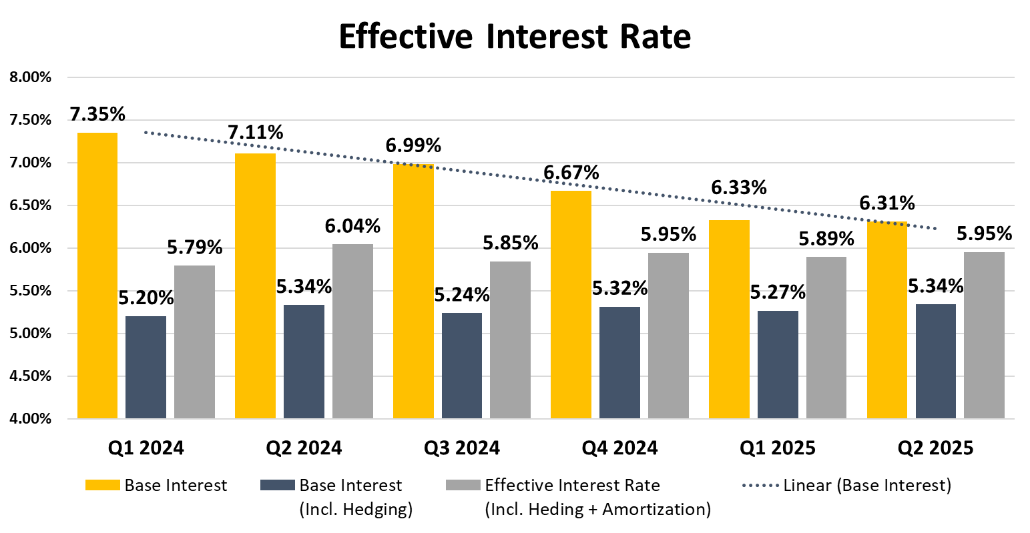


Effective Interest Rate
CAP Amortization excluded from the P&L. Per IFRS, it is presented at its FV on the BS.
CAP Amortization reflects how acquisition costs impact the Effective Interest Rate (EIR).
Our Hedging vehicles are proving effective, reducing the Fund’s EIR by ~83bps in Q2-25
~97 bps reduction without non-cash CAP Amortization effect, (i.e., on a cash flow basis)

Slide 82
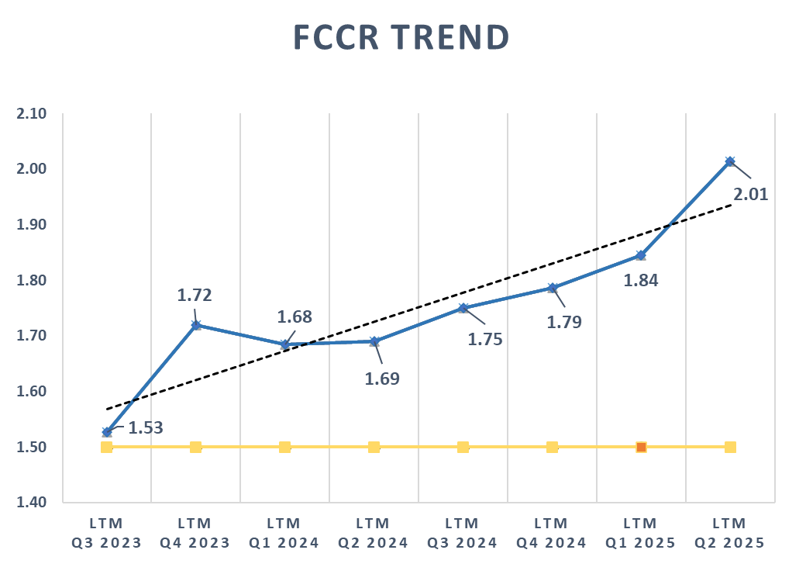
KeyBank Q2 2025 Compliance - FCCR
Key Takeaways
Fixed Charge Coverage Ratio “FCCR”
Increased to 2.01x as of Q2-25, up from 1.84x as of Q1-25
Consolidated Interest Expense
Incremental decline in Consolidated Interest Expense as we continue to utilize proceeds from asset dispositions to pay down the KeyBank facility, reducing our exposure to floating rate debt within the portfolio
Cushion (Nominal Amount)
Increased to $9.3M as of Q1-25, up from $9.3M as of Q1-25
One-Time Income
Within our reported EBITDA, we have included approximately $8.3M of one-time income, primarily from Insurance Proceeds ($6M) and Termination Fee Income ($1.5M)
It's important to note that this income was excluded from the Adjusted NOI for the DSCR calculation as per the definitions set in the credit agreement to calculate the Availability

Slide 83
KeyBank Q2 2025 Compliance – Quarterly Availability Trend Analysis

Slide 84
A/R Specific Allowance - Deep Dive

Slide 85
A/R Aging by Market

Slide 86
Same Store Analysis – Market Comparison (Appendix)

Slide 87
Same Store Analysis – Market Comparison (Appendix)

Slide 88
Same Store Analysis – Market Comparison (Appendix)

Slide 89
Definitions

Slide 90
Definitions (Continued)
Net Operating Income (NOI) Net Operating Income (“NOI”) is a supplemental non-generally accepted accounting principles (“GAAP”) measure of our property operating results that we believe is meaningful because it enables management to evaluate the impact of occupancy, rents, leasing activity and other controllable property operating results at our real estate. We define NOI as operating revenues less operating expenses, which exclude (i) impairment of investments in real estate, (ii) depreciation and amortization, (iii) straight-line rental income and expense, (iv) amortization of above- and below-market lease intangibles, (v) lease termination fees, (vi) property expenses not core to the operations of such properties, and (vii) other non-property related revenue and expense items such as (a) general and administrative expenses, (b) management fee paid to the Adviser, (c) performance participation allocation paid to the Special Limited Partner, (d) incentive compensation awards, (e) income (loss) from investments in real estate debt, (f) change in net assets of consolidated securitization vehicles, (g) income from interest rate derivatives, (h) net gain (loss) on dispositions of real estate, (i) interest expense, (j) gain (loss) on extinguishment of debt, and (k) other income (expense).
Project Cost The amount of cash or cash equivalents paid or the fair value of the other consideration given to acquire an asset at the time of its acquisition or construction, or, when applicable, the amount attributed to that asset. (Including Capex (General Building Improvement, Tenant Improvement and Leasing commission)
Yield on Cost (YoC) % Yield on cost measures income in relation to the total cost of the property. YOC% is calculated as a property's Net Operating Income (NOI) divided by the total project cost.
Same Store NOI We evaluate the performance of the operating properties we own and manage using a “same store” analysis because the population of properties in this analysis is consistent from period to period.

Slide 91
Definitions (Continued)
Funds from Operations (FFO) We define FFO in accordance with the standards established by the National Association of Real Estate Investment Trusts (“NAREIT”). FFO represents net income (loss) (computed in accordance with GAAP), excluding gains (or losses) from sales of depreciable operating property, gains (losses) from sales of land, impairment write-downs of depreciable real estate, real estate related depreciation and amortization (excluding amortization of deferred financing costs and fair market value of debt adjustment) and after adjustments for unconsolidated partnerships and joint ventures.
Core FFO Core FFO excludes transaction costs and non-recurring other expenses.
AFFO To arrive at AFFO, we adjust Core FFO to include realized gains from the disposition of land and development properties, net of current tax expense, and recurring capital expenditures and exclude the following items that we recognize directly in Core FFO: straight-line rents; amortization of above- and below-market lease intangibles; amortization of management contracts; amortization of debt premiums and discounts and financing costs, net of amounts capitalized, and; stock compensation amortization expense.
Base Interest Rate The actual interest that was paid during the period. Effective Interest Rate (w/o Origination Fee Amortization) Base Interest Rate + Amortization of Hedging Costs. Effective Interest Rate Base Interest Rate + Hedging Costs + Origination Fee Amortization
Recovery Ratio Recoveries Income/Recoverable and Non-Recoverable Expenses. This KPI will be used to measure our ability to collect recoveries from tenants.

Slide 92
Definitions (Continued)
Leasing Spread Rent increase of signed leases over prior lease annual base rent PSF expressed in NNN terms, excluding vacant spaces.
Economic Occupancy Net Base Rent received after deduction of free rent and income lost due to vacancy expressed as a percentage of maximum potential rent.
Transaction NOI Monthly contractual income annualized less YTD recoverable and non-recoverable expenses and remaining budget for recoverable and non-recoverable expenses. Income Adjustments include One-time accounts such as Concessions, Prior Year Income, Bad Debt, Insurance Income, Late fees, Termination fees, Holdover fees and Security Deposit.
Net Income from Downtime Annualized income from lease commencements during period less pro-rata income during period from expiring leases. Net Absorption Sum of square feet that became physically occupied, minus the sum of square feet that became physically vacant during a specific period. Total Lease Value Base Annual Rent contracted over the lease term excluding OpEx. CTV (Cost to Value) TI, LC and FR​ as a % of Total Lease Value. Capex is not included in the calculation.

Slide 93



Properties NOI Actuals vs. Budget – Apollo
In Progress –
Fund Finance
Key Takeaways
Net Operating Income (NOI)
Overall, Q2-2025 NOI aligns with the budget
Total Income
Total income is generally in line with the budget
Non-Recoverable Expenses
1157 Battlecreek - $98K Painting, landscaping, installations
Various - $12K General R&M unbudgeted
Bad Debt Expense
During the quarter, we recovered some previously recognized bad debt, which was not included in the budget
1
2
3
$181M
WA Total Cost
29
Buildings
1.7M
SF
Budget column represents 2025 property-level budgets.

Slide 94
Same Store Analysis - Apollo
OPEN –
Fund Finance
$180M (16.9%)
WA Total Cost
29
Buildings
1.7M (16.3%)
SF

Slide 95
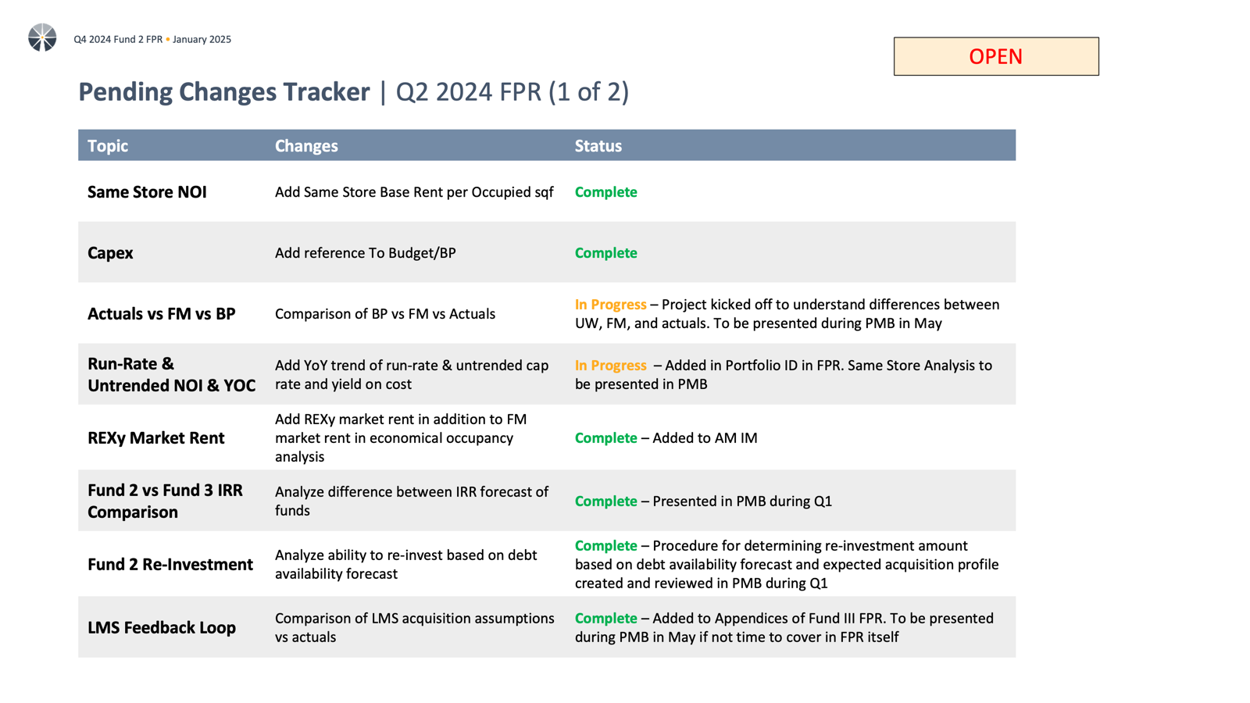
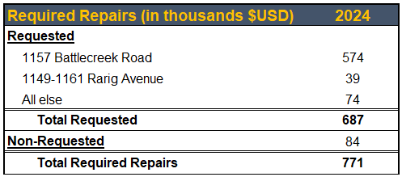
Escrows: Required Repairs- Apollo
OPEN –
Fund Finance
Key Takeaways
2024 Required Repairs Release

Slide 96
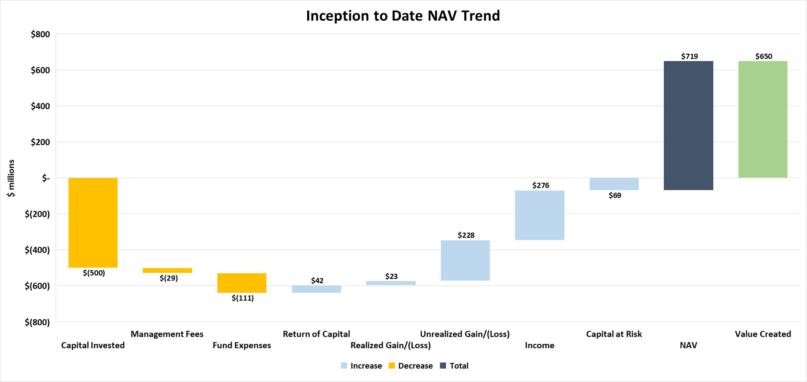
OPEN –
Fund Finance (in progress)

